Slide 1
Synergies between agricultural nitrogen and greenhouse gas regulation
Lake Rotorua, New Zealand
Oliver Browne, Simon Anastasiadis, & Suzi Kerr

Slide 2
Nitrogen and GHG timeline
2005 – nitrogen emissions capped for Rotorua
2008 – NZ’s ETS is legislated
2010 – nitrogen trading for Taupo
2015 – agriculture enters NZ’s ETS
2029 – nitrogen reduction for Rotorua: 250T
Notes:
To GHG and N regulation has been happening and is happening.
We are going to see catchments, like Rotorua, affected by both N and GHG regulation

Slide 3
Motivating Theory
Farms produce output
Two inputs (animals, fertilizer)
Two byproducts GHG & nitrogen
Notes:
Production function is well behaved
Decreasing marginal returns
No saddle point
Cross derivative is positive – complementary inputs

Slide 4
Farmers’ Decision Problem
Price on GHG
Binding cap on permits

Slide 5
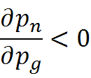
Resulting Relationships
It can be shown:
Implies changes in composite input prices:
Impact on profit:

Slide 6
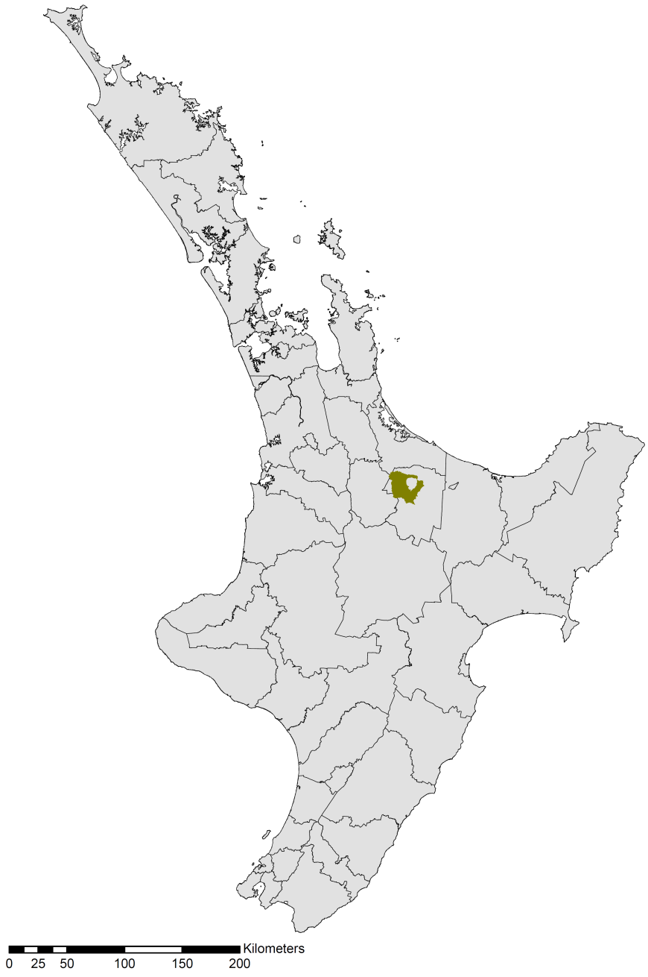
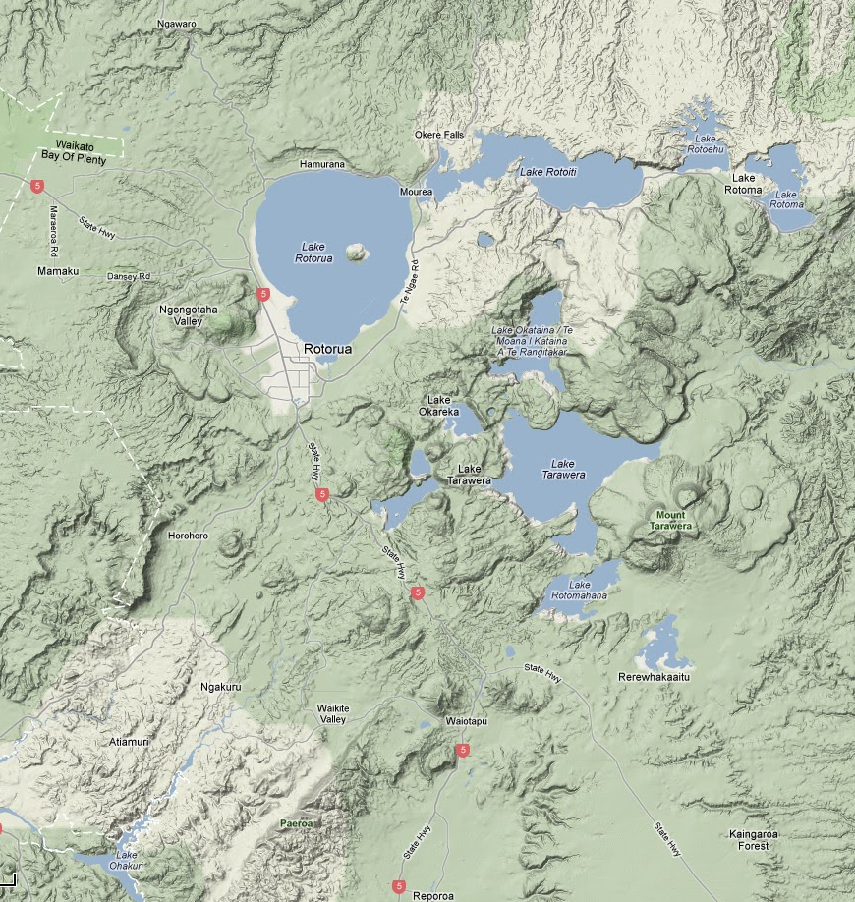
Our case study
Source: TerraMetrics, Google Maps

Slide 7
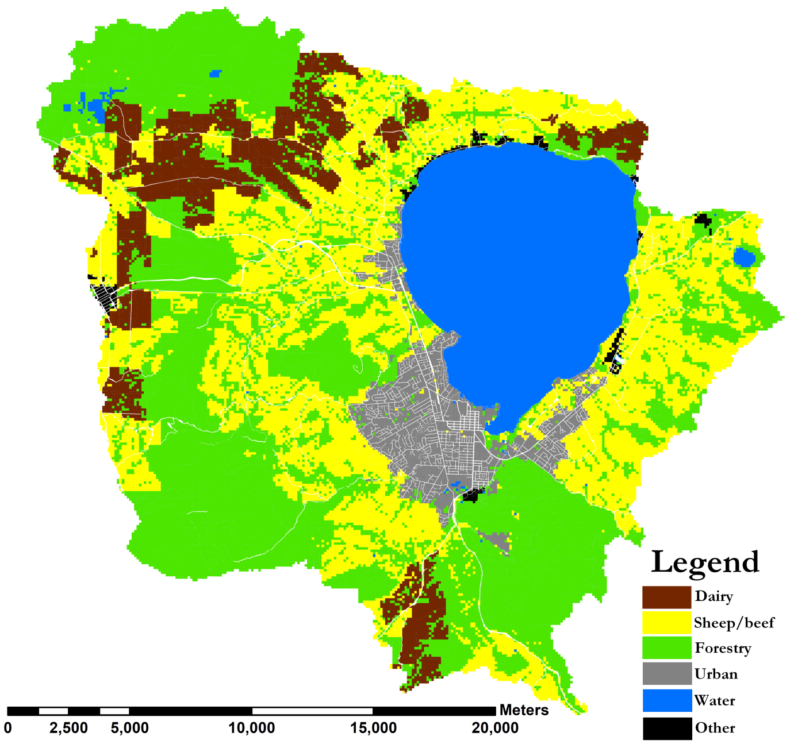
Sources of Nitrogen
Notes:
LURNZ

Slide 8
The ways nitrogen reaches the Lake
47% via surface water
53% via groundwater
Surface water
Groundwater
LAKE
Notes:
NIWA – has done modelling of the transition of nitrogen from the land to the lake. These percentages come from ROTAN.
Assume no attenuation

Slide 9
Target and emissions – the gap
Current exports

Slide 10
Water Quality is Temporal
Nitrogen in the lake
Nitrogen target

Slide 11
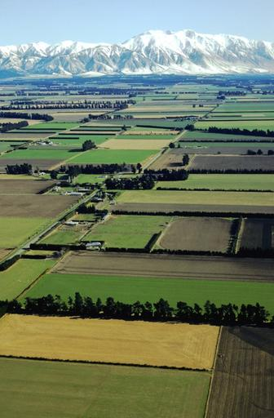
Farm Modelling
Unit record data ➔ Heterogeneity
Representative farms ➔ Abatement
Emissions estimated using OVERSEER software

Slide 12
Distribution of Nitrogen Emissions
Sheep/Beef
Dairy
Notes:
MAF Farm Monitor Project
All NZ

Slide 13
Distribution of GHG Emissions
Sheep/Beef
Dairy

Slide 14
GHG Emissions / N Emissions
Dairy
Sheep/Beef

Slide 15
On-farm Nitrogen Abatement
Dairy
Sheep/Beef
Forestry
Notes:
Duncan Smetan – Different Farms under same managment
Calculated using a representative farm (constructed by combining unit record data)
Simulation modelling in Farmax and OVERSEER

Slide 16
Nitrogen Abatement with GHG
Dairy
Sheep/Beef
Forestry
Notes:
Calculated using a representative farm (constructed by combining unit record data)
Simulation modelling in Farmax and OVERSEER

Slide 17
Modelling Heterogeneous Farms
Type
Dairy
Nitrogen
High
GHG
High
Medium
Low
Medium
Low
Sheep/beef
X
X
Notes:
3 Pieces of Data
-Esti

Slide 18
Abatement Curves without GHG

Slide 19
Abatement Curves with GHG

Slide 20
Three Regulatory Environments
Nitrogen trading only
Trading cap set to mitigate 60% nitrogen
GHG regulation only
Carbon price: $25 per Tonne co₂-eq
Both Nitrogen and GHG regulation
Notes:
Nitrogen trading only – trading cap is set to mitigation X%X percent of agricultural N leaching
GHG regulation only – farmers face an international carbon price of $25 per Tonne co2-equivalent

Slide 21
Impact on Nitrogen Leaching
Before regulation | Nitrogen trading | GHG price | Both regulations
220 | 88 | 187 | 88
Difference | -132 | -33 | -132
Percentage | 60% | 15% | 60%
Units = Tonnes nitrogen leached

Slide 22
Impact on GHG Emissions
Before regulation | Nitrogen trading | GHG price | Both regulations
112 | 56 | 73 | 19
Difference | -56 | -39 | -93
Percentage | 50% | 34% | 83%
Units = 1000’s Tonnes CO₂-equiv

Slide 23
Impact on Profits (Before Permits and Credits)
Before regulation | Nitrogen trading | GHG price | Both regulations
14.2 | 8.8 | 11.1 | 7.6
Difference | -5.4 | -3.1 | -6.6
Percentage | 38% | 35% | 59%
Units = $ millions

Slide 24
Impact on Profits (After Permits & Credits)
Before regulation | Nitrogen trading | GHG price | Both regulations
14.2 | 5.2 | 13.1 | 7.2
Difference | -9 | -1.1 | -7
Percentage | 63% | 21% | 53%
Units = $ millions

Slide 25
Prices on Emissions
 | Nitrogen trading | GHG price | Both regulations
Nitrogen price | $54 | - | $38
GHG price | - | $25 | $25

Slide 26
Impact on Land Use Change

Slide 27
Conclusions

Slide 28
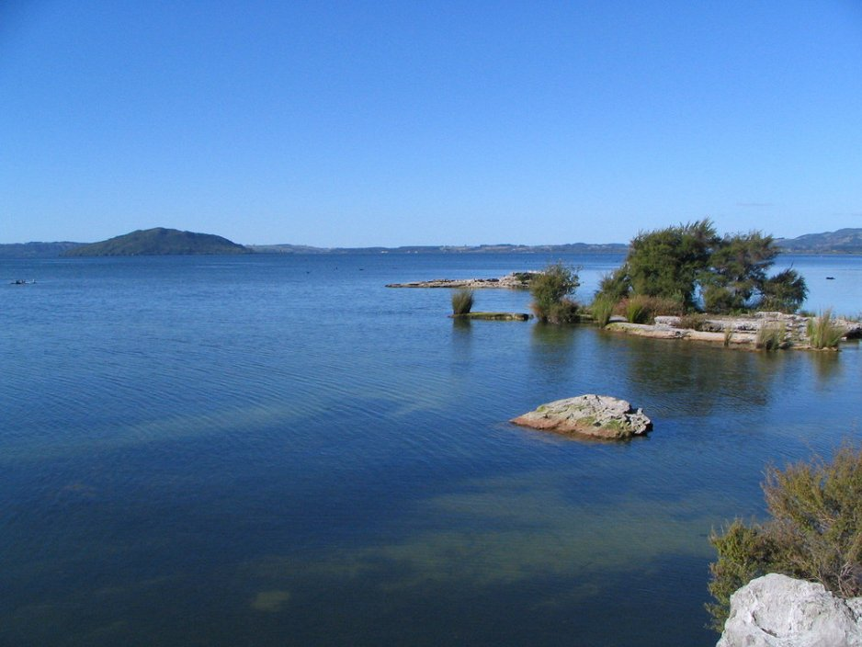
www.motu.org.nz

Slide 30
Distribution of Farm Profits
Sheep/Beef
Dairy

Slide 31
Profits / N Emissions
Sheep/Beef
Dairy

Slide 32
Profits / GHG Emissions
Sheep/Beef
Dairy

Slide 33
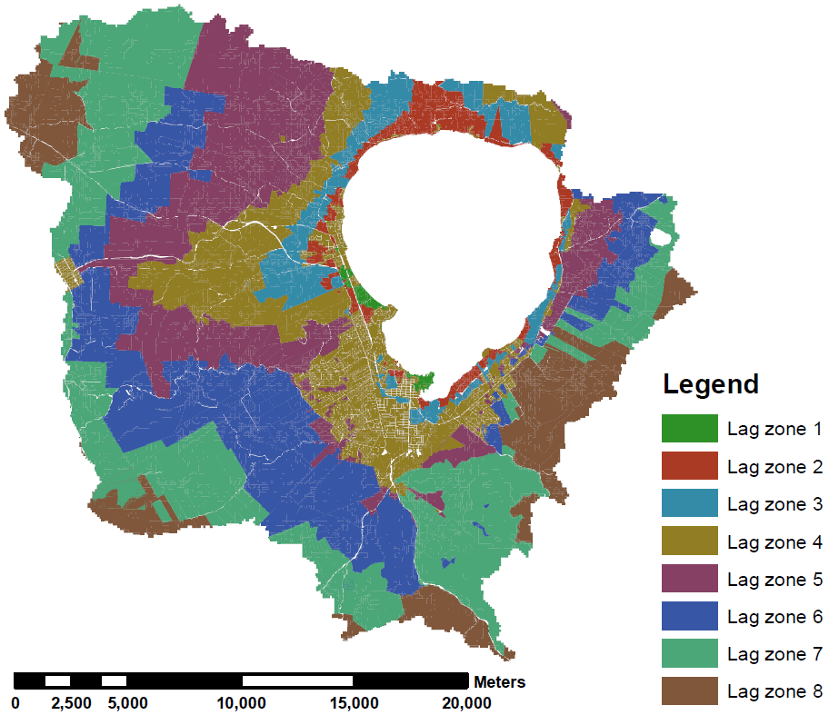
Modelling Nitrogen in Groundwater

Slide 34
Modelling the lag times

Slide 35
Modelling the lag times

Slide 36
The NManager Model
Given the regulation NManager determines:
Stringency regulation to meet the environmental target
The loss of profit from land use
For a specific farmer
For the entire catchment

Slide 37
Model Assumptions
Perfect competition
Foresight
Information
Costs of changing land use are small
No fixed costs for farm management
Price convergence

Slide 38
Input to NManager
ROTAN
Biophysics
NIWA
OVERSEER
Biophysics
AgResearch
FARMAX
Farm modeling
AgResearch
Economics
Motu
NManager
NIWA & Motu

Slide 39
Nitrogen Leaching and Profit

Slide 40
GHG Emissions and Profit

Slide 41
Nitrogen Leaching and GHG Emissions

Slide 43
Sub-intro page
Subtitle text

Slide 44
Bullet Points
Bullet Point 1
Sub bullet point

