Slide 1
LURNZ
Introduction & upcoming beta-2 release
By Motu Environment team
Notes:
The only difference between the “Forestry – Monday” and “Agricultural – Tuesday” is the example demonstrated in slide 13 (and onwards)

Slide 2
What is LURNZ?
• Land Use in Rural New Zealand model
• Simulates four land uses dynamically and spatially
•Partial equilibrium model
• Analyzes the implications of climate policy
Notes:
Some text taken from poster found in:
R:\Professional Associations and Conferences\Edinburgh Conference 2010 May Suzi\Poster

Slide 3
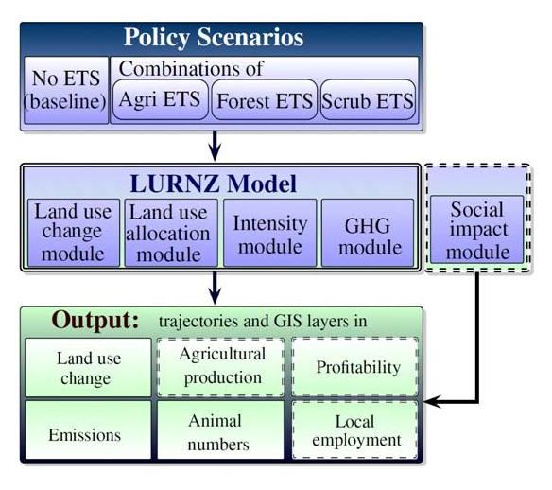
Overview
Notes:
BULLET POINT OPTION ONE WITH MUTED GREEN BKGD & LOGO HORIZONTAL.
Text Gill Sans & Motu Purple for brand consistency.
- To action double click text box.

Slide 4
The Beta-2 Release
• Initial Beta release February 2011
• New release replaces previous beta
• Available soon for download via FTP
• Just finalizing data availability agreements
• We want to encourage feedback and collaboration

Slide 5
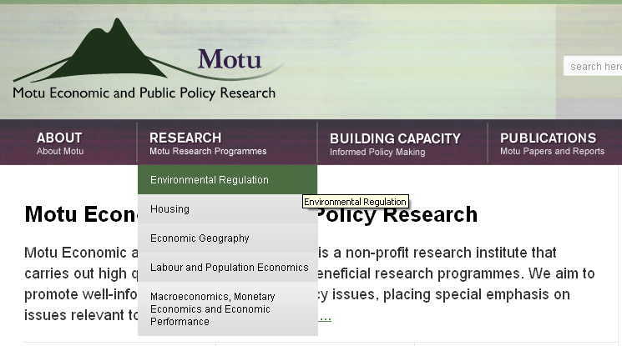
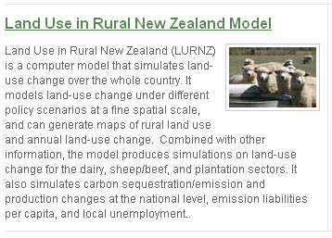
Further Information – Motu Website

