Slide 1
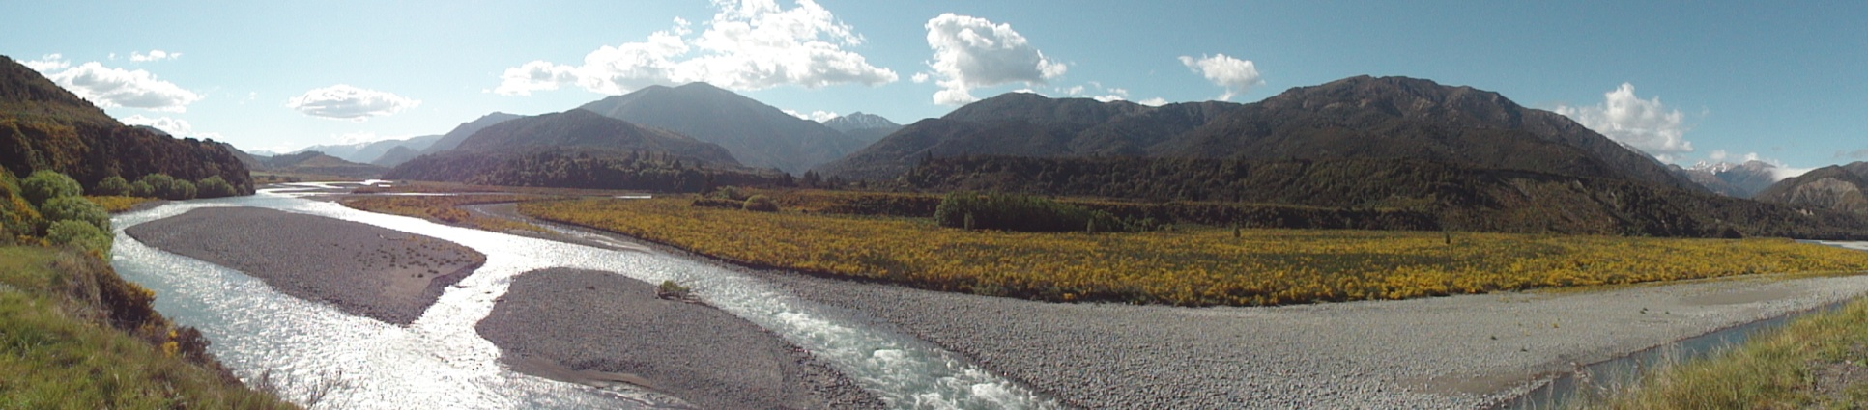
Economic Impacts of GHG and Nutrient Reduction Policies in New Zealand
Adam Daigneault
Landcare Research
Motu Climate Economics Research Workshop
Wellington
20 March 2012
This research was made possible by the generous funding of MSI & MAF-SLMACC

Slide 2
Motivation
Global market pressures to enhance farm output through intensive farming practices (e.g., fertilizer, irrigation, etc.)
Intensive land-based enterprises are large contributors of greenhouse gases (GHGs), nutrient and sediment runoff to waterways, etc.
National level emissions trading scheme (ETS)
Targeted water policies at regional scale
  Nutrient reduction and increased irrigation
We use forest and agriculture regional model (NZ FARM) to estimate impacts of two large catchments in NZ
  Hurunui/Waiau catchment, South Island
  Manawatu catchment, North Island

Slide 3
Application
Estimate catchment-level impacts of imposing NZ-ETS and/or nutrient reduction policy on agricultural production
Policy scenarios:
  Baseline: No agricultural ETS, no nutrient constraints
  AgETS: $25/tCO₂e for all on-farm emissions/sequestration
  Nutrient: Catchment-level nutrient constraint at 80% of baseline
  AgETS_NUT: Agriculture ETS & nutrient constraint policy
Scenario | GHG Price on Ag Activities ($/tCO₂e) | Nutrient Caps (tons)
Baseline | None | None
AgETS | $25.00 | None
Nutrient | None | 80% baseline
AgETS_NUT | $25.00 | 80% baseline

Slide 4
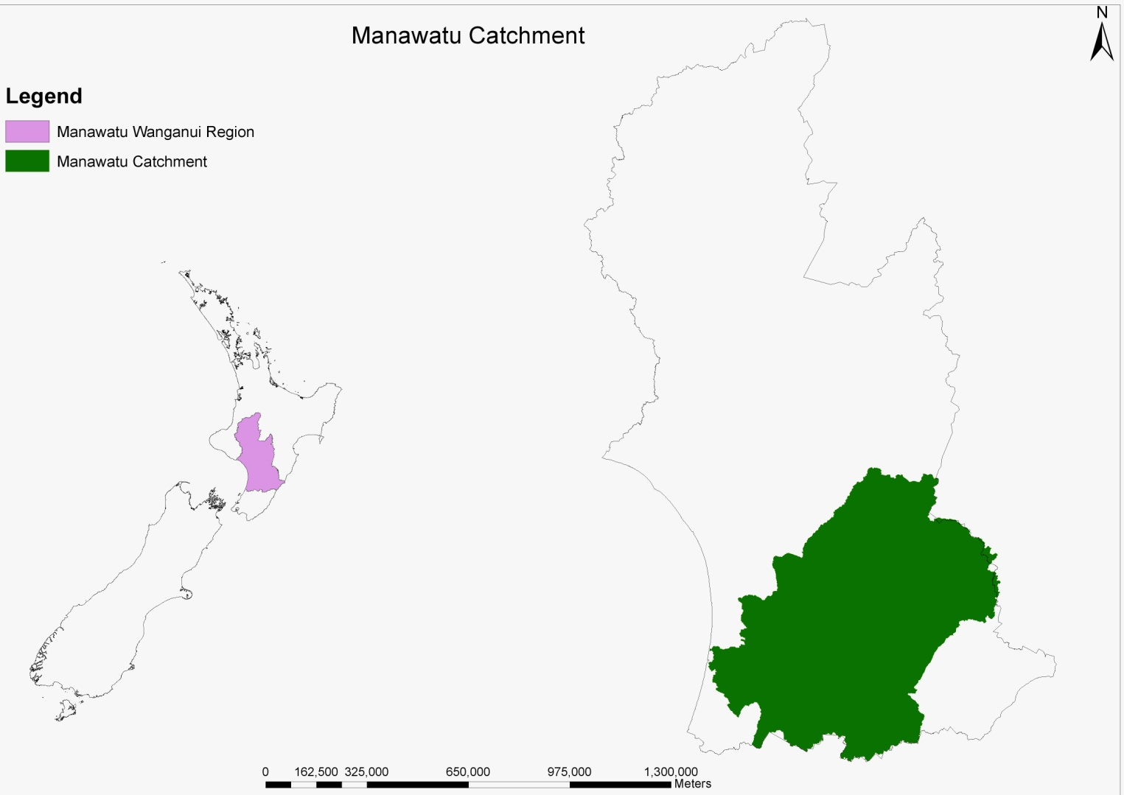
Manawatu Catchment
Total Area:
575,500 HA
Dryland Area:
569,500 HA
Irrigated Area:
6,000 HA

Slide 5
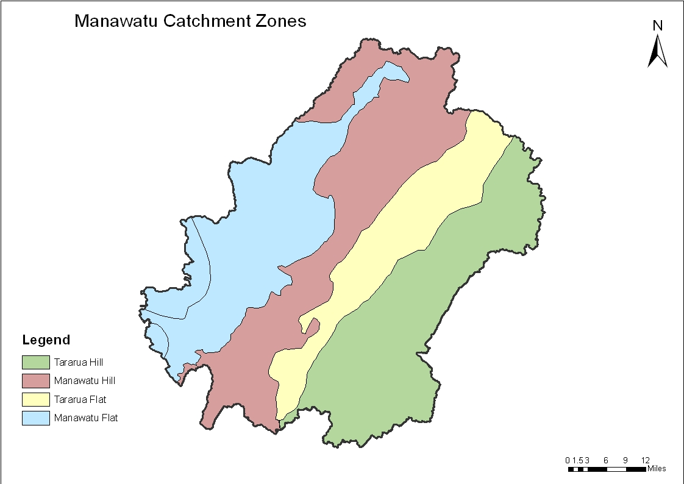
Sub-Zones within Manawatu
Note: area differentiated by productive capability/land use classification

Slide 6
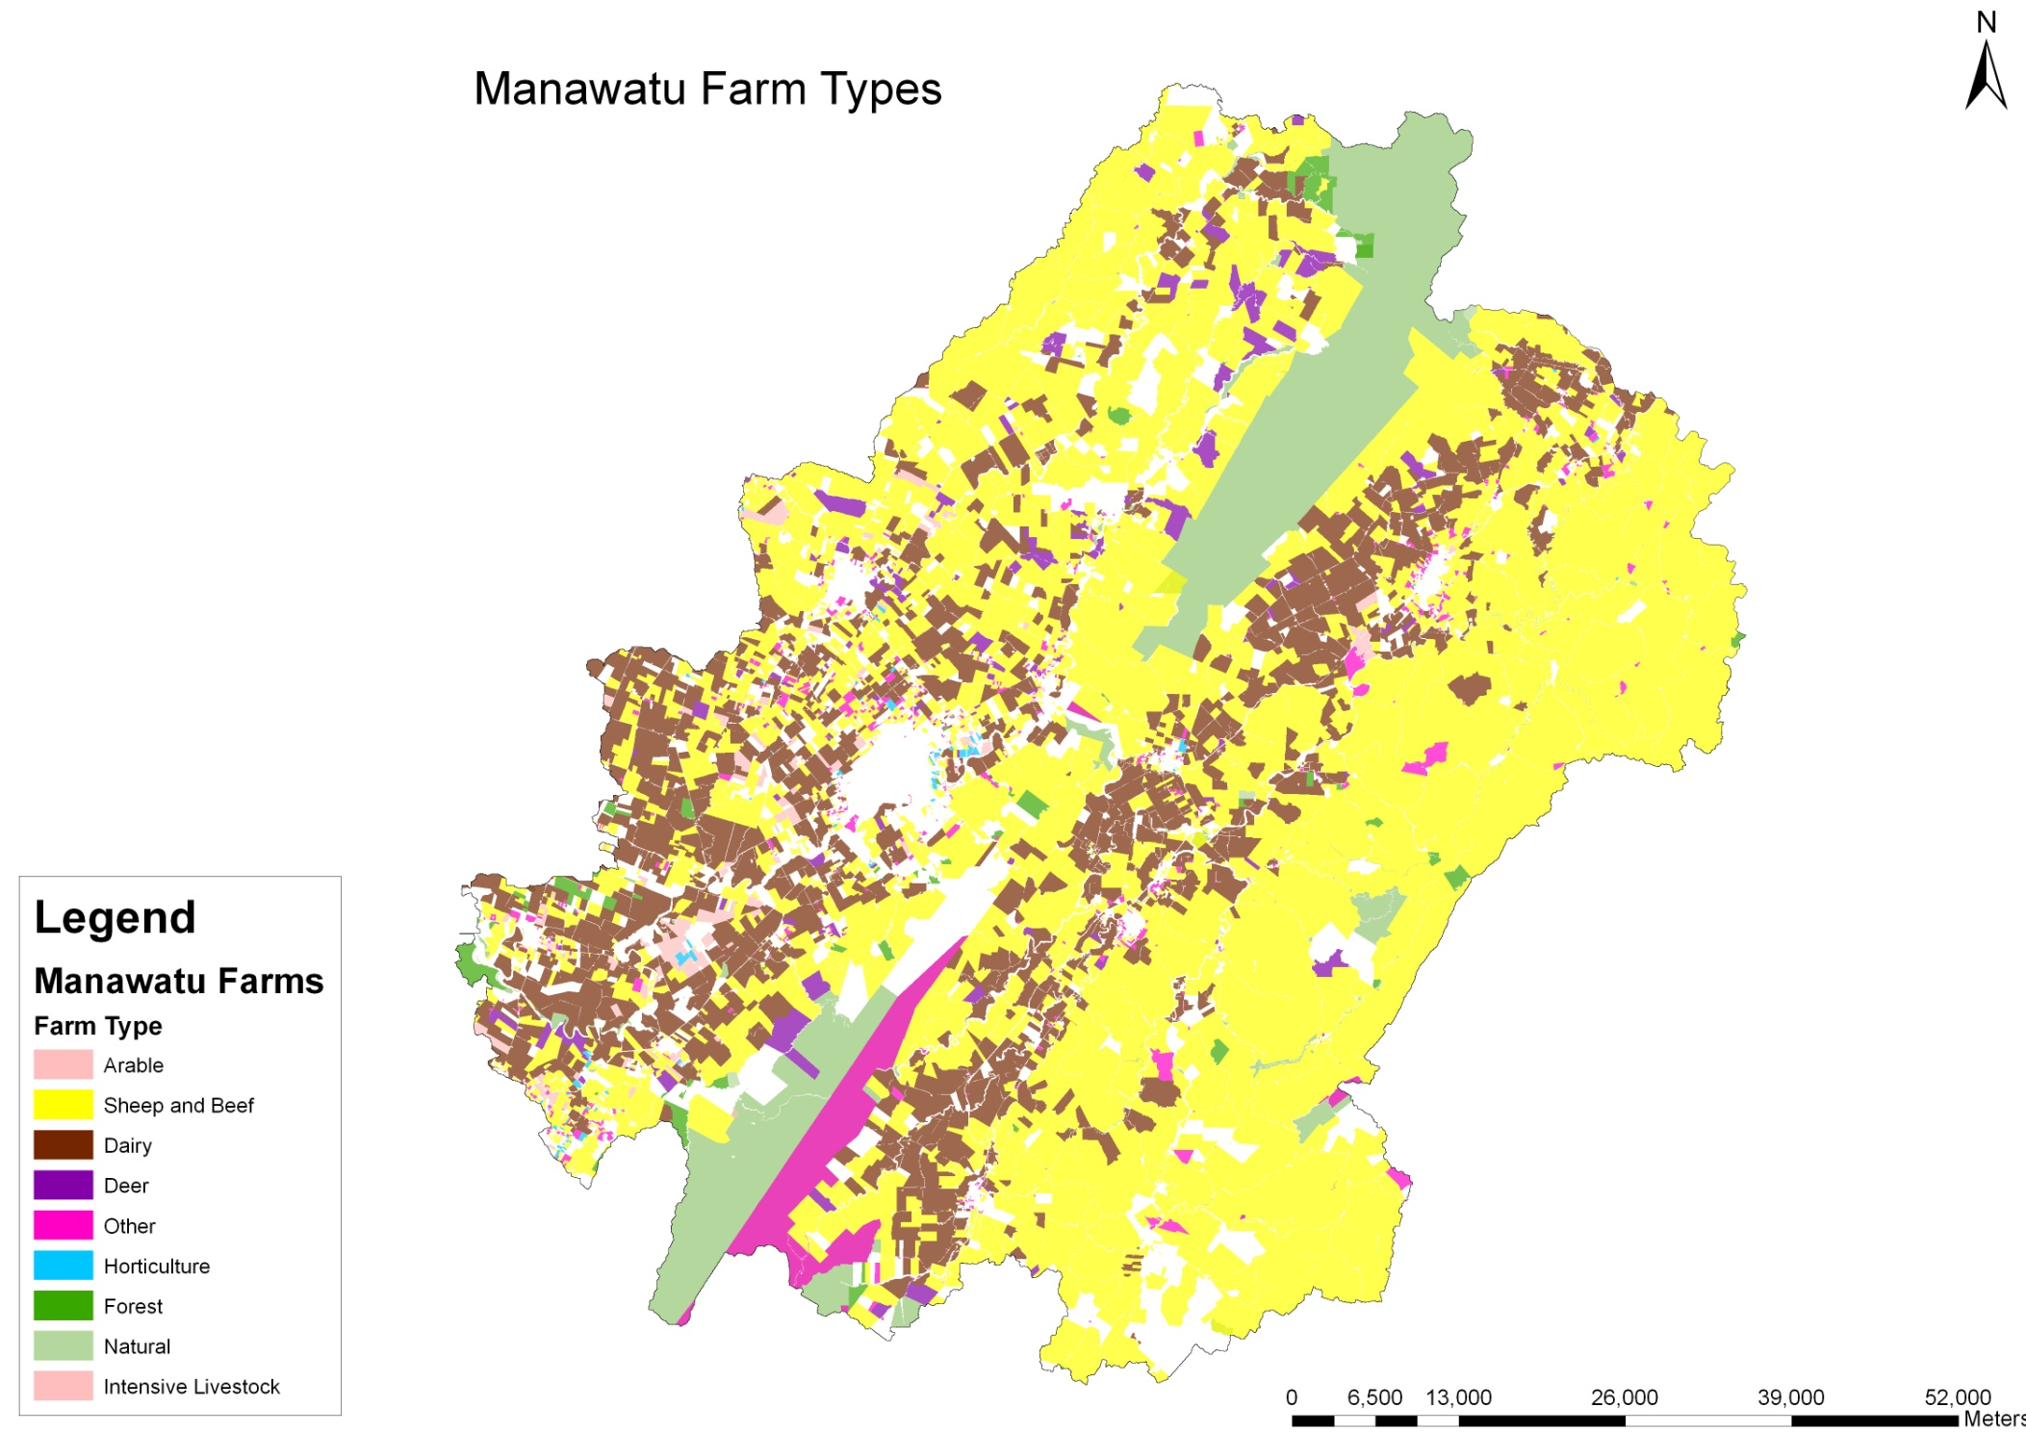

Slide 7
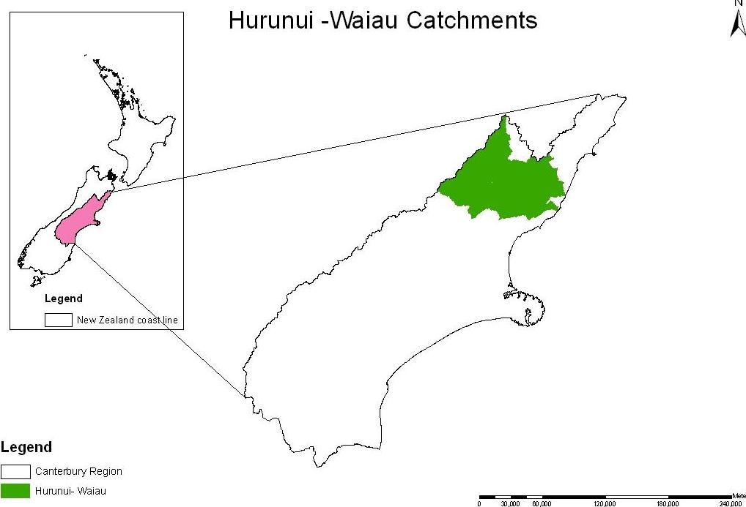
Hurunui/Waiau Catchment
Total Area:
582,100 HA
Dryland Area:
559,900 HA
Irrigated Area:
22,200 HA

Slide 8
Sub-Zones within Hurunui/Waiau Catchment
Note: area differentiated by productive capability/land use classification

Slide 9
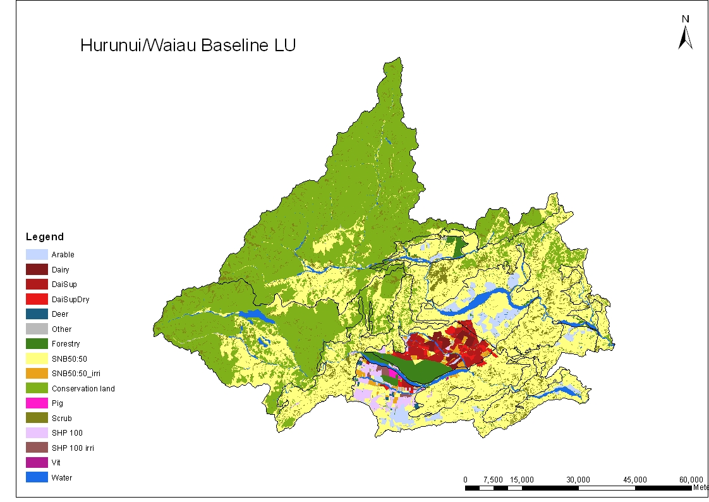
Baseline Enterprise Mix

Slide 10
Manawatu Baseline Results
Net Revenue ($ million) | Total GHGs (tons) | Net GHGs (tons) | N Leaching (tons) | P Leaching (tons)
$308.3 | 3,156,000 | 2,138,800 | 5,800 | 370
Minimal irrigation for dairy on flats
Sheep & beef dominant enterprise
DOC & scrub mostly in hills
Sequestration in native vegetation on scrub reduces net GHGs by about 15%

Slide 11
Hurunui/Waiau Baseline Results
Net Revenue ($ million) | Total GHGs (tons) | Net GHGs (tons) | N Leaching (tons) | P Leaching (tons)
$250.3 | 1,531,000 | 924,000 | 3,040 | 45
Most irrigation on plains
Sheep & beef dominant enterprise
Dairy, arable & pine plantations in plains
DOC dominates hills
Forest carbon sequestration reduces net GHGs

Slide 12
Net Catchment Revenue Impacts
Policies reduce revenue for all regions relative to baseline
Manawatu impacted more by AgETS
Major portion of lost revenue is on plains/flats

Slide 13
Change in Aggregate Enterprise Area
Policies promote expansion of forests, scrub & arable land
Greater enterprise changes in Manawatu
Pastoral enterprises decrease with carbon price
Arable land becomes relatively more profitable because less GHG intensive
Nutrient policy limits conversion to arable
Notes:
Aggregate area of Sheep and beef change minimal, but shift does occur from dryland to irrigated

Slide 14
Catchment-level GHG Impacts
Both Ag ETS & nutrient policy scenarios effective at reducing GHGs
Change in net GHGs dramatically higher because of expanded forest/scrub
Note: Net GHGs account for change in forest carbon sequestration
Notes:
Irrigation gains in GHGs from increased intensity and deforestation
Net reductions because landowners increase area of pine plantations

Slide 15
Breakout of GHGs (tons CO₂e)
Proportion of emissions roughly match latest national GHG inventory figures
Emissions dominated by pastoral production
Baseline forest carbon seq. primarily from native forests
Policy scenario forest seq. from new pine or scrub land
Notes:
Baseline model assumes same proportion of pine cut per annum is re-planted

Slide 16
Nutrient Impacts
Adding carbon price reduces nutrient loadings for Hurunui but not Manawatu
Manawatu → Greater changes in P
Hur/Waiau → Greater changes in N
Difference is area of key enterprises in catchment & mitigation options available
AgETS alone might not help meet nutrient loading targets

Slide 17
Key Impacts with Irrigation
Scenario | Net Revenue (millions) | GHG Emissions (tons CO2e) | N leaching (tons) | P loss (tons) | Irrigated Area (ha)
BASELINE | $250 | 1,531,000 | 3,057 | 45.9 | 31,800
IRRIGATION | 5% | 13% | 11% | 2% | 62%
IRR_GHG | -10% | -20% | 1% | -4% | 62%
IRR _NUT | -3% | -21% | -20% | -20% | 41%
IRR_GHG_NUT | -14% | -38% | -20% | -20% | 41%
Irrigation without regulation increases production and revenue but also environmental outputs
With GHG tax, emissions go down and nutrients are held around pre-irrigation levels
With nutrient policy, GHGs reduced as much as nutrients with less revenue impact
  - Less irrigation is taken up though as a result
With multiple regulation policy, significant reductions in all metrics
  - Net revenue impacted almost as much as policy with no added irrigation

Slide 18
Land Use – Irrigation and Policy
Nearly all irrigation increases in Hurunui Plains
Increases irrigated sheep and beef, dairy, arable
Reduction in dry land sheep and beef, forest
Environmental policies reduce dry land sheep and beef and dairy
GHG policy –Changes in Plains
Nutrients – Changes equally in Plains and Foothills
Dual policy – similar to nutrients

Slide 19
GHG Emissions – Irrigation and Policy
Irrigation increases GHGs, in 2 ways
  Increase in farm based emissions
  Decrease in forest carbon sink
GHG policy reduces emissions and promote forest carbon sequestration
Nutrient policy promotes even more forestry
Dual policy has most dramatic effect

Slide 20
Summary
Co-benefits of nutrient reduction policy do exist at catchment level
Analysis shows that there may not be a ‘win-win’ scenario for reduction in GHGs & nutrients with stand-alone policy
  Nutrient policy reduces GHGs but not vice versa.
  Results driven by enterprise & mitigation options in model
Analysis shows that, unregulated, additional irrigation in Hurunui/Waiau could lead to more environmental outputs
  Imposing additional policy levers could reduce some of these impacts

Slide 21
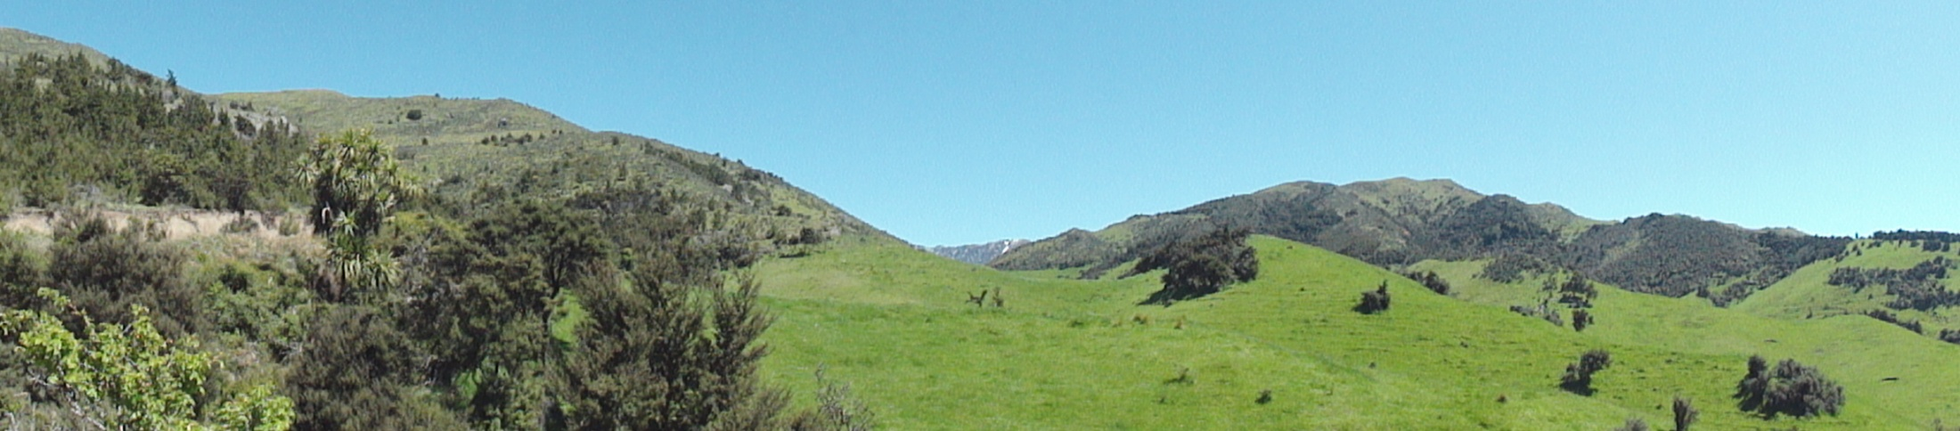
Questions?
Adam Daigneault
Economist
Landcare Research
Auckland, New Zealand
daigneaulta@landcareresearch.co.nz
+64 09 574 4138

