Slide 1
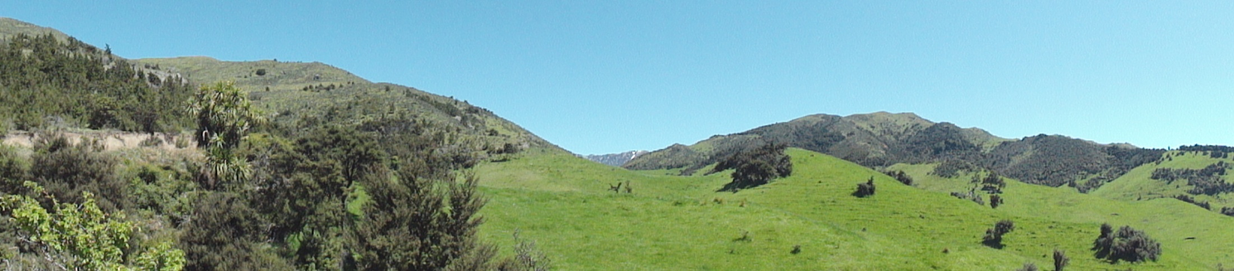
NZ Forest and Agriculture Regional Model (NZFARM)
Adam Daigneault
Landcare Research
Motu Climate Economics Research Workshop
Wellington
20 March 2012
This research was made possible by the generous funding of MSI & MAF-SLMACC

Slide 2
New Zealand Forest And Agriculture Regional Model (NZ-FARM)
A comparative-static, non-linear, partial equilibrium economic model of NZ land use
  Objective is to maximize income from land-based activities
  Sub-region/zone-level spatial scale
  Key outputs include changes in income, land use, GHG emissions, and nutrient leaching
Assess impact of changes in commodity prices, technology, resource constraints on agricultural output
Evaluation of farm, resource or environmental policy on economic and environmental performance indicators
Parameterised for Hurunui/Waiau and Manawatu catchments

Slide 3
Objective Function
Model Objective:
  Landowners maximize net revenue from activities conducted on all major farm enterprises in catchment
Subject to constraints:
  Market Output Prices
  Costs of Production
  Physical Inputs Available
  Land Available
  Irrigation Water Available
  Regulated Environmental Outputs and Taxes
  Model separates catchment into regions/zones and also major soil types
  Important to characterise land productivity
  Nutrient leaching can differ across soil types

Slide 4
Calculating Net Returns in NZ-FARM
Maximizing net revenues is calculated as:
Where:
r = region
s = soil type
l = land use
e = enterprise
m = Mitigation Option
io = activity inputs and outputs

Slide 5
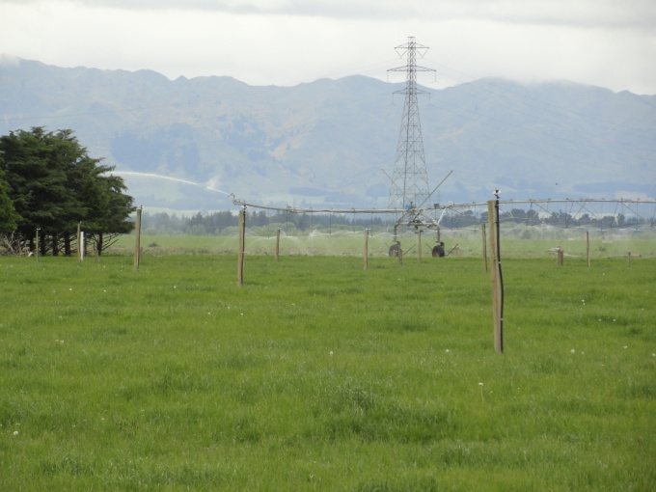
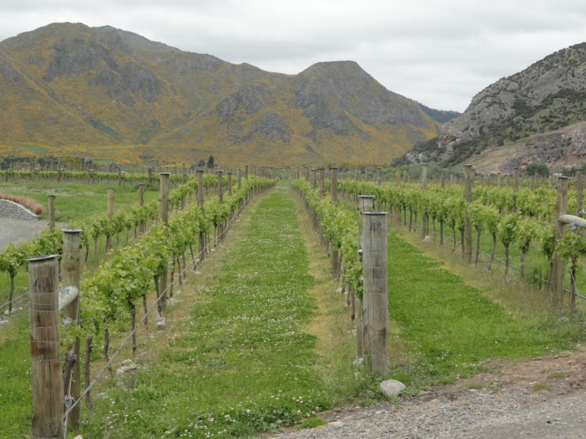
NZ-FARM – Key Components
Land-use/enterprises:
  Pastoral: dairy, sheep, beef, deer
  Arable: wheat, barley, maize
  Horticultural: potatoes, grapes, berryfruit
  Forestry: pine, eucalyptus, native
  Other: scrub and DOC land
Environmental outputs:
  Nutrients: nitrogen and phosphorous
  GHGs for farm and forest activities
  Water use: irrigation area and type
Farm Management Options:
  Keep status quo and pay regulatory tax
  Change enterprise or land use
  Adjust fertilizer and stocking rates
  Add dairy feed pad or apply DCDs
  Enter forest carbon sequestration programme

Slide 6
Enterprise Mix
Stocking Rate
Irrigation Scheme
Fertilizer Regime
Mitigation Option
Land Management
Land Use Class
Environmental payments
Nutrient Loads
NZFARM Maximise π, subject to input constraints
Land Conversion Costs
Water
Environmental Constraints
Economics
Input Costs
GHG Emissions
Output Prices
Soil Type
Environmental Outputs
Economic Output
Agricultural Production
Soil Erosion
Water Yield
GHG emissions
N and P leaching
Livestock Products
Forestry Products
Crops and Horticultural Products
Land-Based Profit
Environmental Costs

Slide 7
Structure of NZFARM Nest and CET Functions
Catchment Area
σ_{S}
Soil Type
Balmoral Soil
Soil Type_{i}
σ_{L}
Land Use
Pasture
Forest
Land Use_{j}
σ_{E}
Enterprise
Dairy
Sheep & Beef
Pastoral Enterprise_{k}
σ_{M}
Land Management
Land Management_{l}
Irrigation with Feedpad
Agricultural Production
σ_{P}
Milk Solids
Calves
Product_{m}

Slide 8
Data Needs
Land area (ha) – Land use databases
Soil type – Fundamental Soil Layers
Enterprise type (ha) – Land use maps and Agribase
Inputs – various sources
  Water (mm/day)
  Fertilizer (kg/ha/yr)
  Stocking rates (units/ha)
  Animals purchased (units/ha)

Slide 9
Data Needs
Yields – various sources
Variable costs – various sources
Fixed costs – various sources
Output prices – MAF prices for all of NZ
Environmental outputs
  N and P leaching rates – from OVERSEER and/or SPASMO
  GHGs – Calculated from farm-level inputs and NZ GHG Inventory data and equations

Slide 10
Baseline

Slide 11
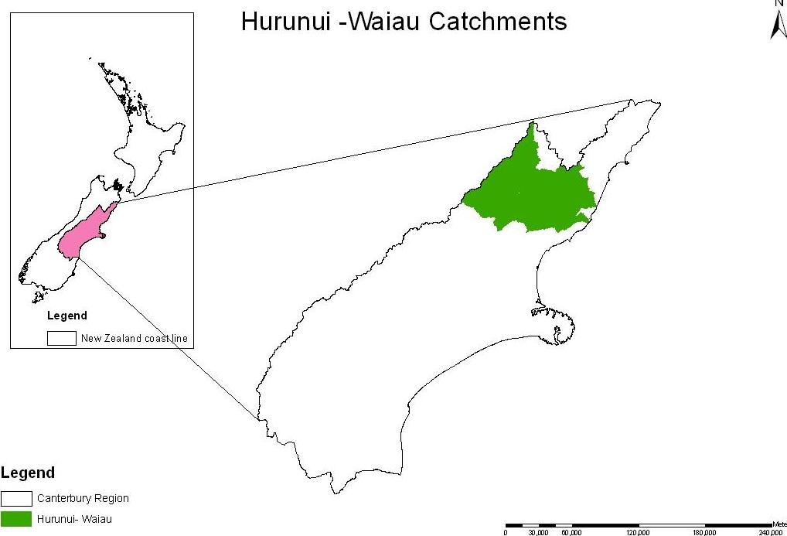
Hurunui/Waiau Catchment
Total Area:
582,100 HA
Dryland Area:
559,900 HA
Irrigated Area:
22,200 HA

Slide 12
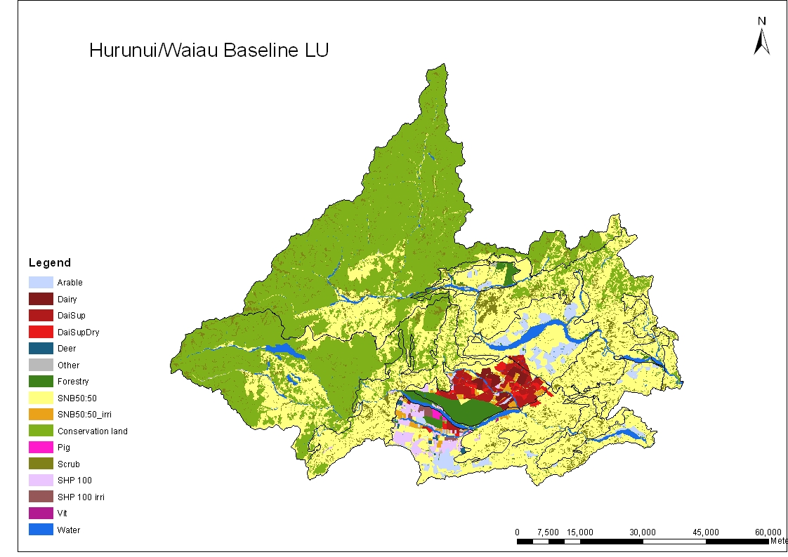
Baseline Enterprise Mix

Slide 13
Sub-Zones within Hurunui/Waiau Catchment
Note: area differentiated by productive capability/land use classification

Slide 14
Key Components of NZ-FARM – Hurunui Catchment
Region | Soil Type | Land Type | Enterprise | Irrigation Scheme | Fertilizer Regime | Mitigation Option | Variable Costs | Fixed Costs | Product Output | Environmental Indicators | Product Inputs
Plains Foothills Hills | Lismore Balmorals Hatfield Templeton | Pasture Cropland Horticulture Forest Scrub (Manuka-Kanuka) Dept of Conservation | 3 Cows per ha, wintered on farm 3 Cows per ha, wintered off farm 3.5 Cows per ha, wintered on farm 3.5 Cows per ha, wintered off farm 4 Cows per ha, wintered on farm 4 Cows per ha, wintered off farm Deer Pigs Mix of Sheep and Beef Grazing 100% Sheep Grazing 100% Cattle Grazing Grapes Berryfruit Wheat Barley Pine Radiata | Irrigated Land Dry Land | 100% rec. all nutrients 80% rec. N, 100% rec. all other nutrients 60% rec. N, 100% rec. all other nutrients 50% rec. N, 100% rec. all other nutrients No N, 100% rec. all other nutrients 0% rec. Lime, 100% rec. all other nutrients No fertilizer applied | Change stocking rate Change fertilizer regime Payments for forest carbon sequestration Add DCDs Construct Dairy feed Pads | Beef stock replacement costs Sheep Stock Replacement cost Deer Stock replacement cost Dairy Stock replacement cost Pig stock replacement cost Wages - permanent Wages - casual Animal Health Dairy shed breeding Electricity Cartage Fertiliser Fertiliser application Fuel Shearing Seeds Imported Feed costs - hay & silage . . . . | Property taxes Insurance Land prep Tree planting Forest harvest Cultivation Forest management fee Herbicide application Fungicide application Pruning Thinning Harvest costs Harvest preparation DCD Application Feed pad construction | Milk solids Dairy calves Lambs Mutton Wool Cull cows Heifers Steers Bulls Deer: hinds Deer: stags Deer: velvet Pigs Berryfruit Grapes Wheat Barley Logs for pulp and paper Logs for Timber Other Misc. | N leached (kg N) P leached (kg P) Methane from animals (kg CO2e) N2O emissions – direct excreta and effluent (kg CO2e) N2O emissions – indirect excreta and effluent (kg CO2e) CO2 emissions - N fertiliser (kg CO2e) CO2 emissions – Lime (kg CO2e) N2O emissions – direct and indirect N from fertiliser (kg CO2e) CO2 emissions – fuel (kg CO2e) CO2 emissions - electricity use (kg CO2e) Annual Forest C Sequestration (kg CO2e) | Dairy calves purchased Lambs purchased Rams purchased Ewes purchased Cows purchased Heifers purchased Steers purchased Bulls purchased Pigs purchased Dry matter Electricity used Fertiliser used - Urea Fertiliser used - Super Fertiliser used - Lime Fertiliser used - other Nutrients used -N Nutrients used -P,K,S Nutrients used -Lime Nutrients used -Other Fuel used – Petrol . . . .

Slide 15
Model Outputs
Net Revenue ($) | Total GHGs (tons) | Net GHGs (tons) | N Leaching (tons) | P Leaching (tons)
$250,336 ,000 | 1,531,000 | 924,000 | 3,040 | 45

Slide 16
Enterprise Area

Slide 17
Regional Production (tons or k m3)

Slide 18
Average N Leaching Rates

Slide 19
GHG Emissions

Slide 20
Change in N leaching intensity with nutrient reduction policy

Slide 21
Marginal Abatement Costs- GHG Price
Level of per hectare abatement varies across regions and mitigation options.
Carbon sequestration, enteric fermentation are lowest cost options
Most mitigation from tree planting, reducing stocking and fertilizer app. rates
Additional mitigation from DCDs and feed pads for dairy

