Slide 1
Methane matters
From international climate change policy to the New Zealand farm
Motu Climate Economics Research Workshop
20 March 2012

Slide 2
Outline
Part 1: Methane basics
Part 2: Reisinger and Stroombergen 2012
Part 3: Implications for NZ in 2020
Part 4: Metrics
Part 5: Implications for NZ farms in 2020
Summary

Slide 3
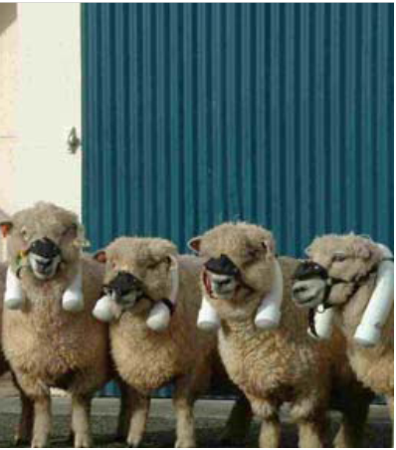
Part 1
Methane
basics

Slide 4
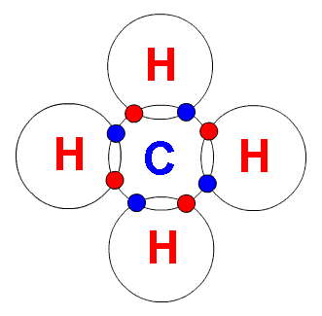
Methane basics
Currently at 2.5 times its level in 1750
- CO2 has increased by about 35%
Second most important GHG
- Contributes almost 1/3 as much to warming as CO2
Agriculture is responsible for about 50% of global methane emissions from humans
Very potent GHG
Degrades in the atmosphere quickly

Slide 5
Compared with only reducing CO2, mitigating all GHGs lowers global mitigation costs by 30-40%

Slide 6
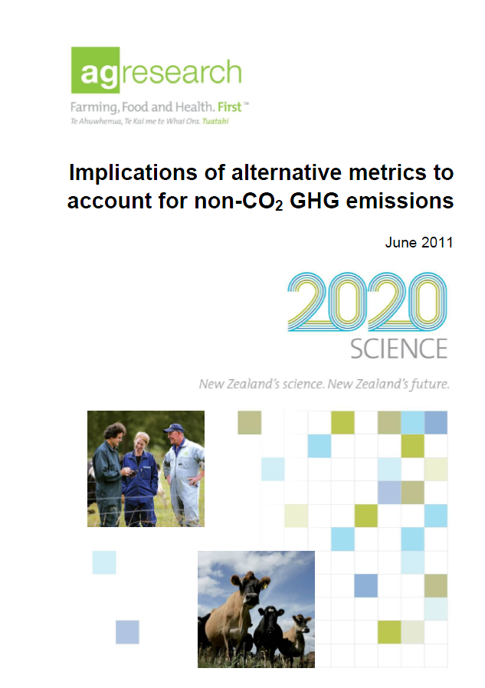
Part 2
Reisinger and Stroombergen 2012

Slide 7
Reisinger and Stroombergen 2012
Model the implications for NZ of various international policy scenarios
Explore the issue of metrics, and how much they matter for NZ
Use four models stuck together – so produce ballpark figures

Slide 8
Three international scenarios to reach a 450ppm target in 2100
All in this together
All emissions included equally around the world, including agriculture
The agricultural conundrum
Agricultural emissions included in national targets, but only NZ takes domestic action
Agriculture out
No agricultural emissions included in mitigation, including NZ
Baseline for comparison
No mitigation anywhere

Slide 9
Global outputs important for NZ
GHG prices
Set at the level to achieve 450ppm by 2100 most efficiently
Livestock commodity price index
A milk and meat composite index to show how GHG prices affect global food prices

Slide 10
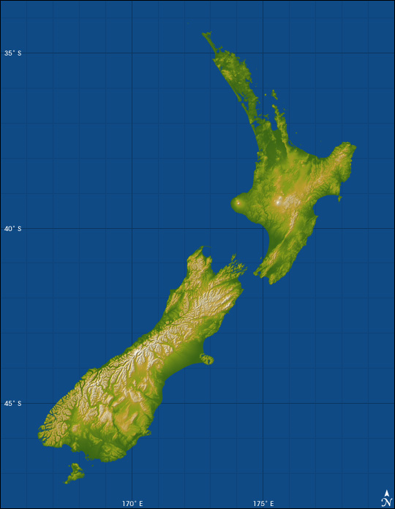
Part 3
Implications
for NZ in 2020

Slide 11
Pricing global agricultural emissions in 2020
Agriculture mitigated everywhere
Methane efficiently mitigated
Global CO2 price = $35
Livestock prices rise 18%
No agricultural mitigation
Methane mitigation too low
Global CO2 price = $77
Livestock prices rise 14%
Notes:
Livestock prices up due to forestry, plus maybe CO2 costs.
Livestock price red because bad for NZ

Slide 12
NZ’s 2020 mitigation targets
All in this together & the agricultural conundrum:
All emissions15% below 1990 levels
Agriculture out:
All non-agricultural emissions 15% below1990 levels
Any net emissions above these levels must be purchased by the government at the international GHG price

Slide 13
NZ domestic policy
All in this together & the agricultural conundrum:
NZETS emissions prices = global GHG prices
NZETS policy otherwise the same. Agricultural emissions at 10% liability in 2015
Agriculture out:
NZETS emissions prices = global GHG prices
Agricultural emissions are not priced

Slide 14
Prices for the scenarios
Scenario | CO2 price/tonne ($NZ) | Methane price/tonne ($NZ) | Livestock commodity price increase over baseline
All in this together | $35 | $866 | 18%
The agricultural conundrum | $77 | $1927 | 14%
Agriculture out | $77 | $0 (ag) | 14%

Slide 15
NZ’s change in RGNDI from no mitigation baseline (GWP)
Notes:
Scenario 1: higher livestock commodity prices and lower CO2 prices offset the higher cost of methane.
Scenario 2: less change in livestock prices, much higher CO2 prices and methane prices that agriculture has to pay
Scenario 3: now the rise in livestock commodity prices more than offsets the costs of emissions as not responsible for agri anymore.

Slide 16
Part 4
Metrics

Slide 17
The two main metrics
GWP – Global Warming Potential
Measures average radiative forcing over a time period
Used under Kyoto
GTP – Global Temperature Change Potential
Measures temperature change at a future point in time
Both compare gases to CO2

Slide 18
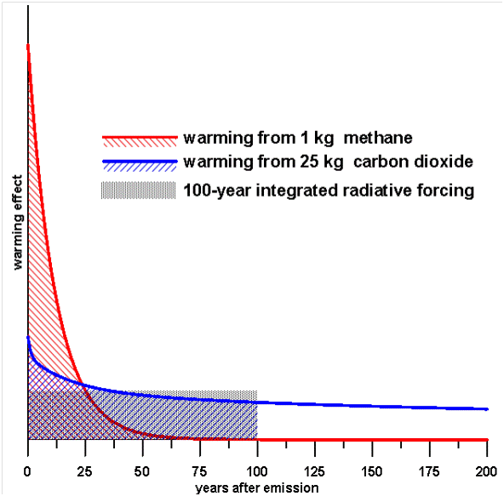
The issue with metrics
Notes:
Radiative forcing = insulation in a house
The time period important

Slide 19
Methane under GWP and GTP
Metric | 20 year | 100 year | 500 year
GWP | 72 | 25 | 8
GTP | 50 | 7 | 0.7
Notes:
N2O, the other important farm emission (about 1/3 of their emissions) changes much less than methane, except lowers a lot for 500 year metrics.

Slide 20
Methane under GWP and GTP
Metric | 20 year | 100 year | 500 year
GWP | 72 | 25 | 8
GTP | 50 | 7 | 0.7
Notes:
Looked at fixed 100 year GWP and GTP as this is the common timeframe used now

Slide 21
Implications of metrics
GWP (25)
Methane almost efficiently mitigated
Global CO2 price = $35
Livestock prices rise 18%
GTP (7)
Methane mitigation too low
Global CO2 price = $42
Livestock prices rise 16%

Slide 22
Prices for the scenarios and metrics
Scenario | Metric | CO2 price/tonne ($NZ) | Methane price/tonne ($NZ) | Livestock commodity price increase over baseline
All in this together | GWP (25) | $35 | $866 | 18%
 | GTP (7) | $42 | $295 | 16%
The agricultural conundrum | GWP (25) | $77 | $1927 | 14%
 | GTP (7) | $88 | $618 | 14%
Agriculture out | GWP (25) | $77 | $0 (ag) | 14%
 | GTP (7) | $88 | $0 (ag) | 14%
Notes:
Go through table
The livestock commodity price index is same for final four scenarios
Remember, final two scenarios similar...

Slide 23
Metrics: NZ’s change in RGNDI from no mitigation baseline
All in this together
Agricultural conundrum
Agriculture out

Slide 24
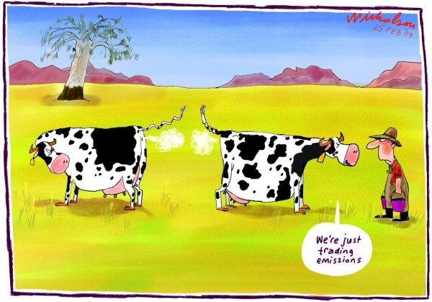
Part 5
Implications
for NZ farms
in 2020

Slide 25
Dairy farm model
Baseline figures for average Waikato dairy farm (Beukes et al. 2010)
Scaled down to 25ha, 3.0 cows/ha
Costs and production assumed constant
Baseline price from average milk price 2002-2011 (MAF 2002-2011)
Costs estimated from Beukes et al. Economic profit
Emissions from Beukes et al. OVERSEER figures, plus a small CO2 component
Output is change in economic profit/ha
No mitigation actions taken

Slide 26
Sheep and beef farm model
Baseline figures for average Central North Island Hill Country (Smeaton et al. 2011)
635ha, 9.8 SU/ha
Costs and production assumed constant
Baseline revenue and costs/SU from average of MAF monitor farm based on (MAF 2002-2011)
Emissions from Smeaton et al. OVERSEER figures, plus a small CO2 component
Output is change in economic profit/ha
No mitigation actions taken

Slide 27
Comparison of model farms to NZ averages - dairy
Farm | Profit/ha before emissions charge (2005$) | Profit/ha after $25 emissions charge (2005$) | Drop in profit/ha (2005$) | Percent drop in profit
Average Waikato (Kerr and Zhang 2009) | $1734 | $1460 | $274 | 16%
Average national (Kerr and Zhang 2009) | $1880 | $1605 | $275 | 15%
My Waikato farm | $2250 | $1977 | $273 | 12%
Notes:
No mitigation or change in milk prices for either paper
Kerr and Zhang used averages of 2000 to 2009 – my averages are slightly later with a higher milk price
Shows how higher commodity prices help buffer against emissions pricing

Slide 28
Comparison of model farms to NZ averages – sheep and beef
Farm | Profit/ha before emissions charge (2005$) | Profit/ha after $25 emissions charge (2005$) | Drop in profit/ha (2005$) | Percent drop in profit
Average hard Central North Island Hill Country (Kerr and Zhang 2009) | $249 | $168 | $81 | 33%
My Central North Island Hill Country farm | $271 | $187 | $84 | 31%
Notes:
No mitigation or change in commodity prices for either farm
Kerr and Zhang used averages of 2000 to 2009 – my averages are slightly later with a higher revenues for sheep and beef

Slide 29
Farm and NZ change compared to no mitigation
All in this together
Agricultural conundrum
Agriculture out
Notes:
Change in profit or RGNDI
Note: 10% liability for farm emissions, except small CO2 component
Magnitude of changes much higher for farmers
So...

Slide 30
Farm and NZ change compared to no mitigation 2020 – 10% liability for agriculture
All in this together
Agricultural conundrum
Agriculture out
Notes:
Go through one column first
Sheep and beef doesn’t do as well as dairy – more sensitive to GHG pricing
Dairy may be overstated though, sheep and beef understated due to livestock prices being combined?

Slide 31
Dairy costs as a percentage of baseline profit – 10% liability for agriculture
10% liability
100% liability
All in this together
Agricultural conundrum
Agriculture out
Notes:
CO2 costs much higher in scenarios 2 and 3
Note though that even with 10% liability, GTP offset the higher price of CO2 with a lower price for methane

Slide 32
Farm and NZ change compared to no mitigation 2020 – 100% liability for agriculture
All in this together
Agricultural conundrum
Agriculture out
Notes:
Note – RGNDI here same results as before
Much more tough for farmers here. GWP worse for scenarios 1 and 2 due to 100% liability.
Sheep and beef is hit hard due to low revenue/ha
Overall, now agriculture out preferred by farms.
Scenario 1 – Dairy profits still rise by around 20%, so efficient compared to the world.
Sheep and beef falls slightly under GWP, and rises slightly under GTP
Scenario 2 – very tough for sheep and beef – go out of business well before 2050. Dairy still not too bad, even an increase under GTP, with price rise still enough to offset.
Best under scenario 3 – agriculture prices rise, but no liability for non-CO2 emissions
So better for agriculture under scenario 3 with 100% liablity
Also note, again, that the only difference between Scenario 2 and 3 for agriculture in NZ is they pay for the emissions while everyone else doesn’t, vs they don’t. Slightly different from the NZ government perspective.
Furthermore, NZ’s national targets are set within the context of international policy. No agriculture, NZ would probably face a stronger target

Slide 33
Dairy costs as a percentage of baseline profit – 100% liability for agriculture
All in this together
Agricultural conundrum
Agriculture out

Slide 34
Most likely scenario?
All in this together
Agricultural conundrum
Agriculture out

Slide 35
Summary
Farms see impacts of emissions charges much more than NZ
Best for NZ is all in this together, and with 10% liability this is best for farmers too
Second best is agriculture out
GWP vs GTP changes things little, but may matter more for farmers
NZ government needs to take international policy into account when setting target, and farmer liability
Reality post-2020: probably GWP, and somewhere in between all in this together and the agricultural conundrum
Notes:
Bullet 2 – if we want all agri in everywhere, NZ must be included...

