Slide 1

Measuring land use responses to changes in economic returns in New Zealand:
Just how slow is land use adjustment?
Alex Olssen and Suzi Kerr

Slide 2

Motivation
Climate policy affects returns. What is the effect on land use?
  Modelling ETS scenarios? Thinking about the AGS?
How important are dynamics?
  Hornbeck, forthcoming
Econometrically
  Based off observed behaviour (Stavins, 1990)

Slide 3
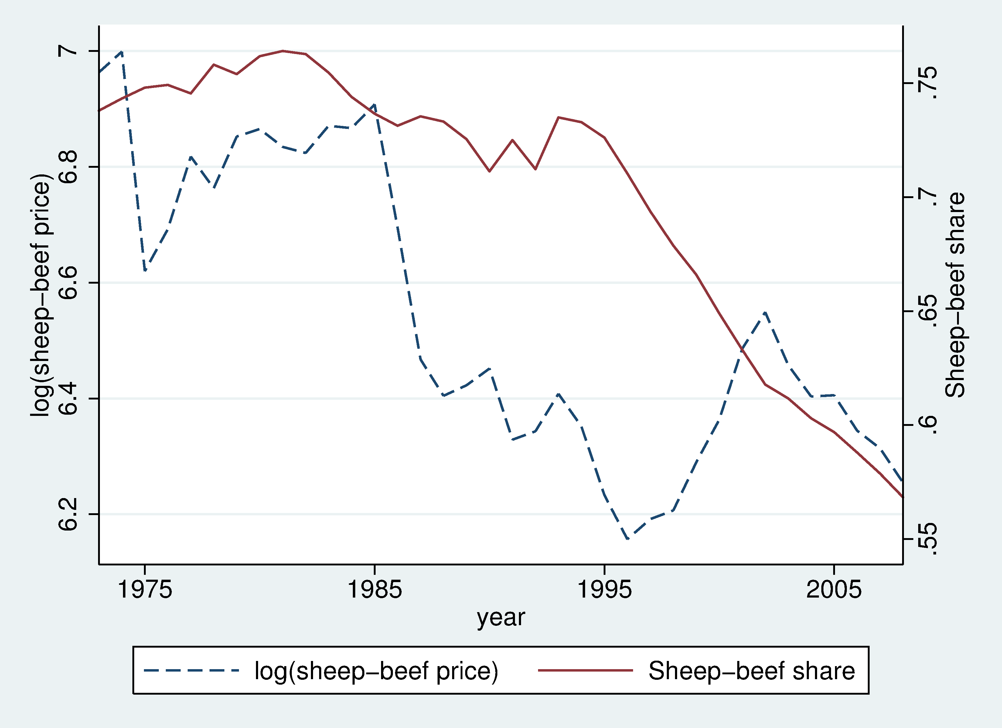
Sheep-beef share and price 1972-2008

Slide 4
Data
National time series data (1972-2008)
Land area
Proxy for economic returns
Interest rates

Slide 5
Land area data
Land area
  Agricultural Production Survey 1972-1996 and 2002-2008 (SNZ)
    Pasture, Forestry, Horticulture, Total farm land
    Scrub defined as the residual
  Dairy and sheep-beef land 1980-2008 (MWES)

Slide 6
Economic returns proxy
Commodity prices
  Exogenous
  History of price supports (adjust as in Anderson, 2007)
Dairy
  Milk solids price (LIC)
Sheep-beef
  Overseas Trade Merchandise (SNZ)
    HS0201-0202, HS020410-HS020443, HS5101
Forestry
  Logs and poles export value and volume (MAF)

Slide 7
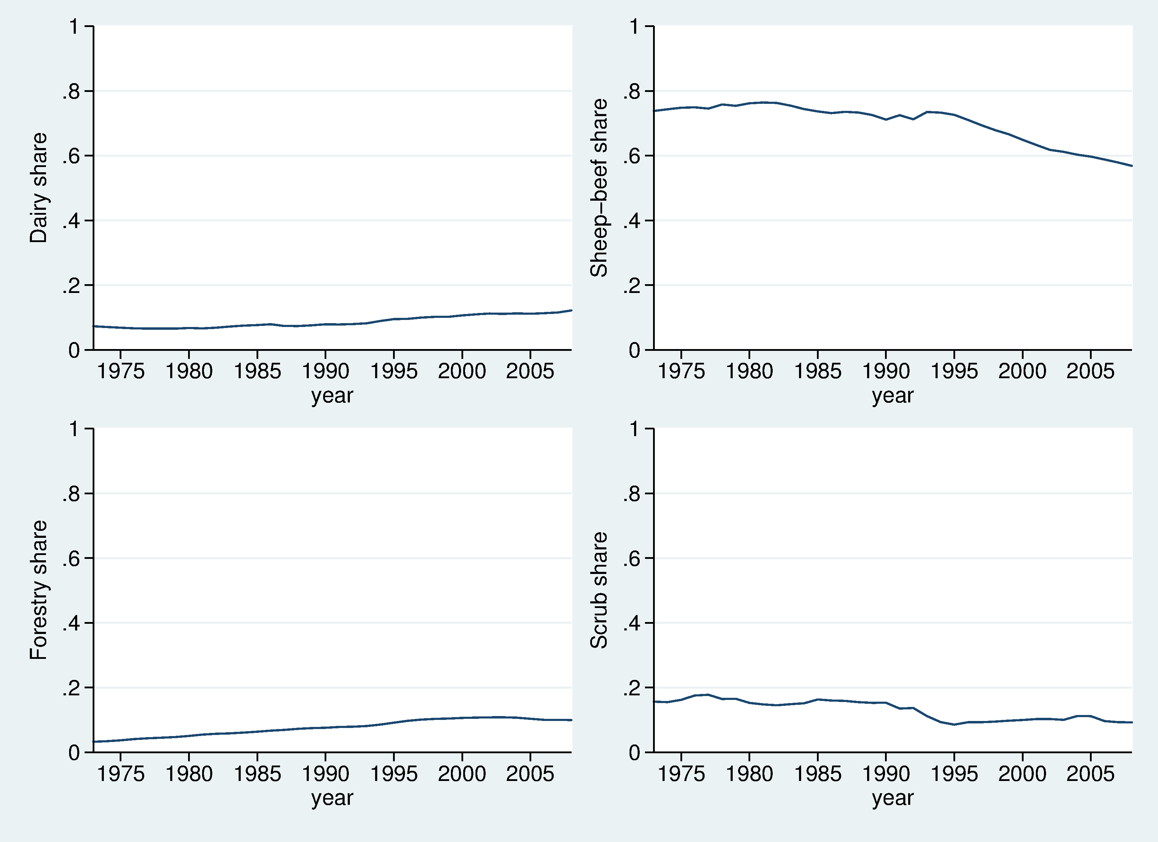
Land use 1972-2008

Slide 8
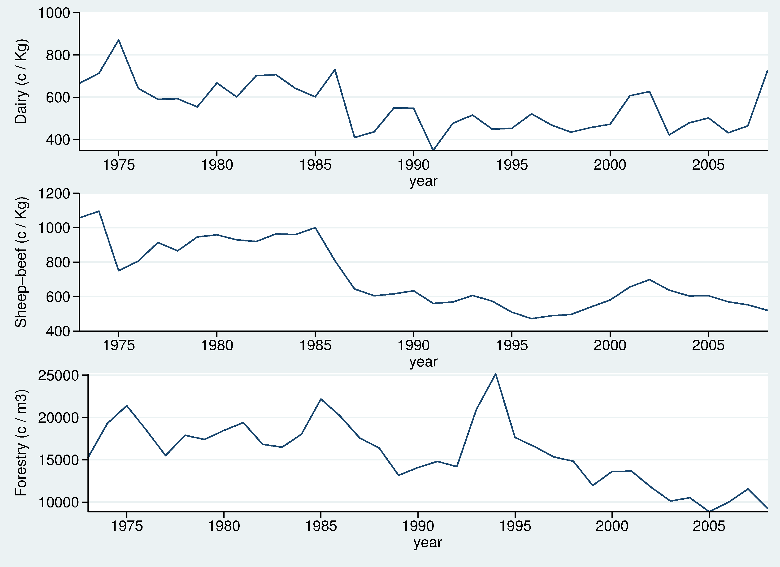
Commodity prices 1972-2008

Slide 9

Estimating equation
General dynamic model (Anderson and Blundell, 1982)
Short and long run responses are identified
Adjustment parameters not individually identified

Slide 10
Short-run effects effects
 | Change in log dairy price | Change in log sheep-beef price | Change in log forestry price
Change in dairy share | 0.000 | 0.008** | 0.006**
 | (0.002) | (0.003) | (0.002)
Change in sheep-beef share | 0.004 | 0.029** | 0.021***
 | (0.009) | (0.014) | (0.001)
Change in forestry share | 0.001 | 0.000 | 0.005***
 | (0.001) | (0.001) | (0.001)
Change in scrub share | -0.006 | -0.037 | -0.032
 | (-) | (-) | (-)

Slide 11
Long-run effects
 | Lagged log dairy price | Lagged log sheep-beef price | Lagged log forestry price
Change in dairy share | 0.007 | -0.053** | 0.063
 | (0.015) | (0.026) | (0.049)
Change in sheep-beef share | -0.041* | 0.106** | -0.099
 | (0.024) | (0.042) | (0.079)
Change in forestry share | 0.013 | -0.102* | 0.102
 | (0.030) | (0.053) | (0.101)
Change in scrub share | 0.139 | 0.020 | 0.050
 | (-) | (-) | (-)

Slide 12
Dynamic specification
 | AR(1) | PA | Static | Static
D.F. | 15 | 15 | 9 | 9
LR-statistic | 50.2*** | 42.3*** | 148.7*** | 156.6***
C.V. 1% | 30.6 | 30.6 | 21.7 | 21.7

Slide 13
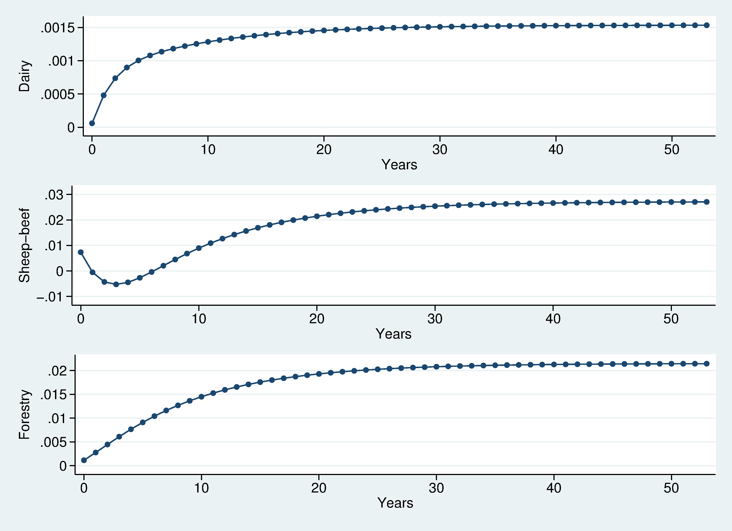
Gradual land use change

Slide 14
Takeaway
Land use responses to commodity prices estimated
Dynamics matter
Land use change estimated to be gradual

