Slide 1
LURNZ Simulations
Example output and methodology
Alex Olssen, Levi Timar,
Simon Anastasiadis, Suzi Kerr

Slide 2
Outline
What is LURNZ
Land use change module
Allocation module
Intensity module
Greenhouse gas module
Experiments

Slide 3
LURNZ
Land Use in Rural New Zealand (LURNZ)
Can simulate national ETS policy
Outcomes include
Land use change
Land use intensity
Greenhouse gas emissions
Cost to communities (forthcoming)

Slide 4
Land use change module
Based of econometric work in Olssen and Kerr (forthcoming)
Inputs
Coefficients of land use response to commodity prices
Price projections
Carbon price

Slide 5
Land use change $25 carbon price

Slide 6
Actual prices in LURNZ and SONZAF

Slide 7
Converting carbon prices to effects on commodity prices
Milk solids (2008)
Estimate emissions per kg of milk solids
Median lifespan 6.31 years (LIC)
5.31 * 323 * 6.14 = 10544 kg co2-e per cow MILK ONLY
Carcass weight 203 kg (SNZ)
203 * 7.19 + 1980 = 3589 kg co2-e per cow MEAT ONLY
(10544 + 3589) / 5.31 * 323 = 8.23 (NO FERT)

Slide 8
Forestry and scrub

Slide 9
A problem with dairy

Slide 10
Allocation module
Based on econometric work by Timar (2011)
Inputs
Probabilities from a multinomial choice model
2008 land use map
National level land use change (first module)
Allocates changes in land use (understates)

Slide 13
Allocation module heuristic

Slide 14
Allocation algorithm example
Typical scenario
Dairy up, sheep-beef down, forestry up, scrub down
1. Best land to dairy
2. Worst sheep-beef to scrub
3. Scrub to forestry

Slide 15
Intensity and GHG Modules
Guiding principles
Exogenous land use intensity (but dynamic)
Spatial heterogeneity in simulated intensity and emissions
On aggregate, consistency with NZ National Inventory

Slide 16
Methods
Calculate IEF for a relevant production process from the Inventory
Use spatial variation in production process to estimate heterogeneous emissions
Project forward components via trends fitted to historical changes
Ensure results consistent with Inventory and other data sources

Slide 17
Equations
Dairy emissions per hectare
$${E_{it}^{d}=IEF}_{t}^{d}\frac{1}{m_{t}}{MS}_{it}+{IEF}^{f}f_{t}^{d}$$
Sheep-beef emissions per hectare
$$E_{it}^{sb}=r_{i}\left[{IEF}_{t}^{s}{SR}_{i}\right]+{\left(1−r_{i}\right)\left[{IEF}_{t}^{b}{SR}_{i}\right]+IEF}^{f}f^{sb}$$

Slide 18
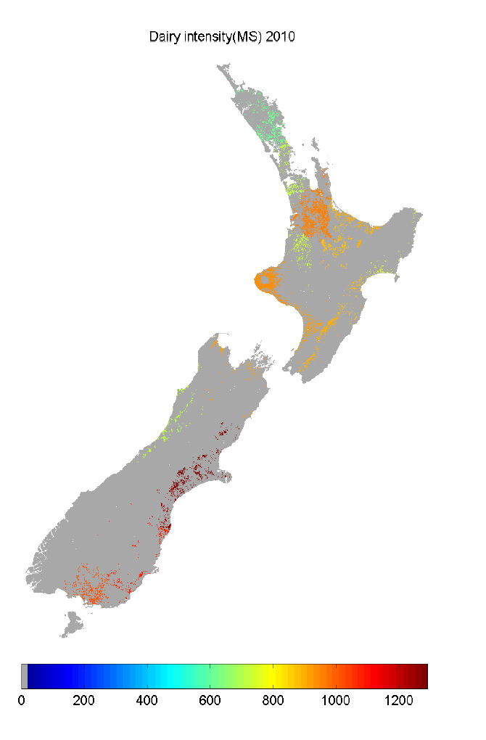

Slide 19
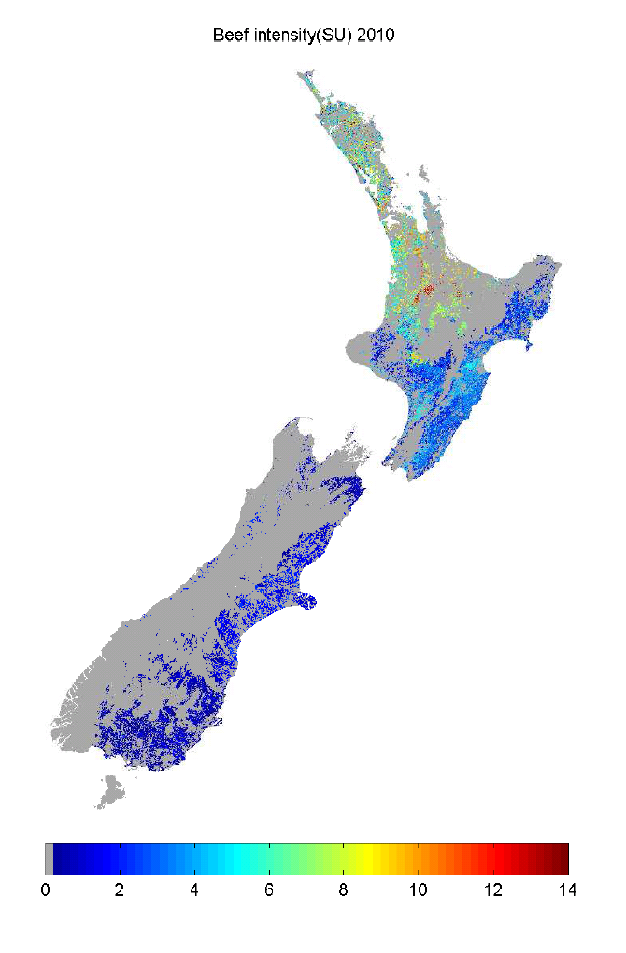

Slide 20
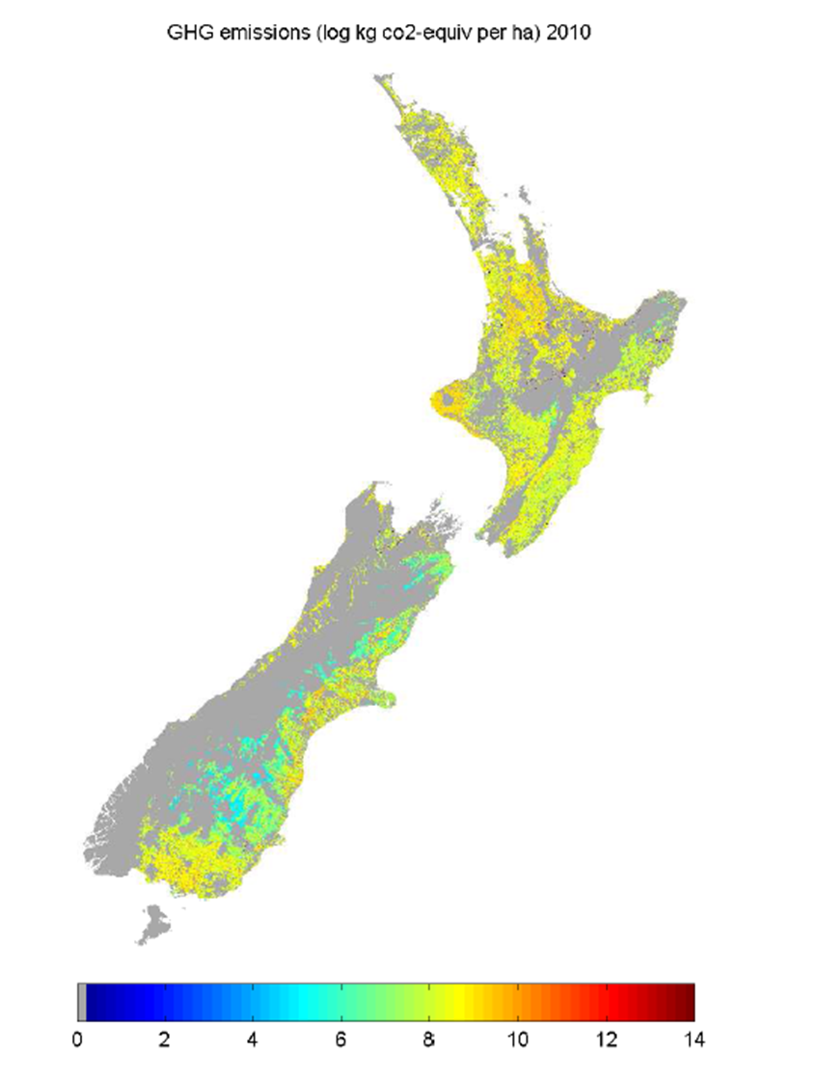

Slide 21
Possible experiments
ETS scenarios
Agriculture in or out
Water quality policy that affects price
Productivity or price shocks

