Slide 1
Electricity markets, perfect competition
and energy shortage risks
Electric Power Optimization Centre
Andy Philpott
Electric Power Optimization Centre
University of Auckland
http://www.epoc.org.nz
joint work with
Ziming Guan, Roger Wets, Michael Ferris
The University of Auckland

Slide 2
Electricity markets and perfect competition
"Private market disciplines are important in competitive industries. And the energy market is becoming increasingly competitive. And the government, in our experience, is not an adaptable, risk-adjusted 100 per cent owner of assets in competitive markets.“
Bill English, NZ Minister of Finance, Energy News, Nov. 9.
Electric Power Optimization Centre
Q: How competitive is the market?
Q: How can you tell?
The University of Auckland

Slide 3
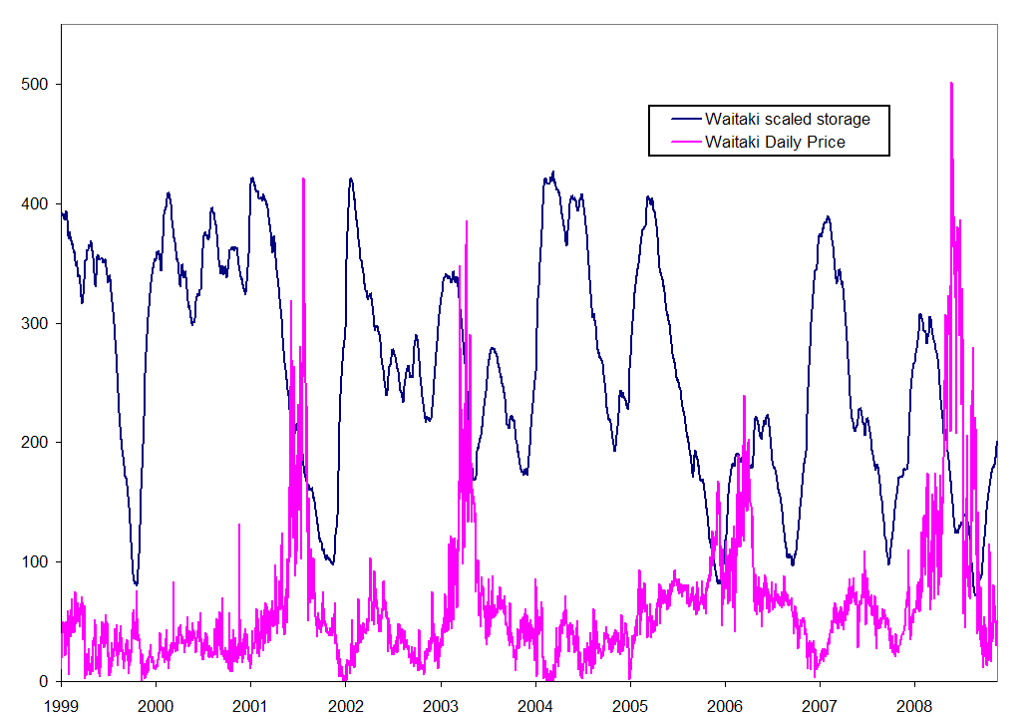
Dry winters and prices
Electric Power Optimization Centre
The University of Auckland

Slide 4
Research question
Electric Power Optimization Centre
What does a perfectly competitive market look like when it is dominated by a possibly insecure supply of hydro electricity?
The University of Auckland

Slide 5
An equilibrium result
Suppose that the state of the world in all future times is known, except for reservoir inflows that are known to follow a stochastic process that is common knowledge to all generators. Suppose that, given electricity prices, these generators maximize their individual expected profits as price takers.
There exists a stochastic process of market prices that gives a price-taking equilibrium. These prices result in generation that maximizes the total expected welfare of consumers and generators.
So the resulting actions by the generators maximizing profits with these prices is system optimal. It minimizes total expected generation cost just as if the plan had been constructed optimally by a central planner.
Electric Power Optimization Centre
The University of Auckland

Slide 6
An annual benchmark
Solve a year-long hydro-thermal problem to compute a centrally-planned generation policy, and simulate this policy.
We use DOASA, EPOC’s implementation of SDDP.
We account for shortages using lost load penalties.
In our model, we re-solve DOASA every 13 weeks and simulate the policy between solves using a detailed model of the system. We now call this central.
  includes transmission system with constraints and losses
  river chains are modeled in detail
  historical station/line outages included in each week
  unit commitment and reserve are not modeled
Electric Power Optimization Centre
The University of Auckland

Slide 7
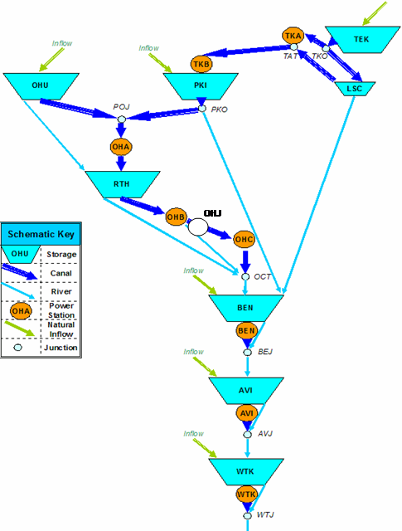
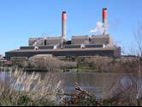
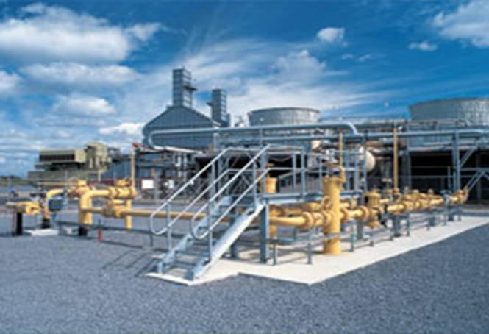
Long-term optimization model
demand
demand
WKO
Electric Power Optimization Centre
MAN
N
H
S
HAW
The University of Auckland
demand

Slide 8
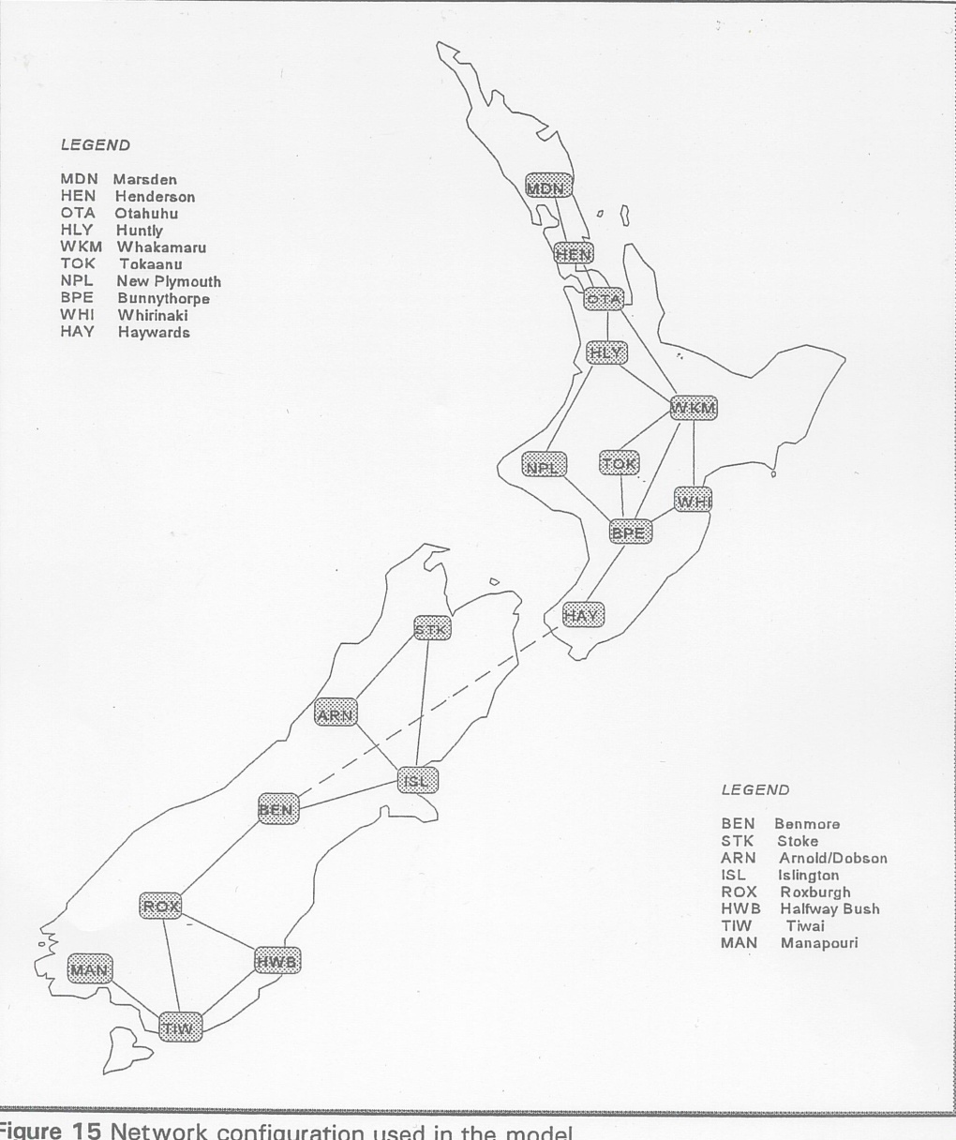
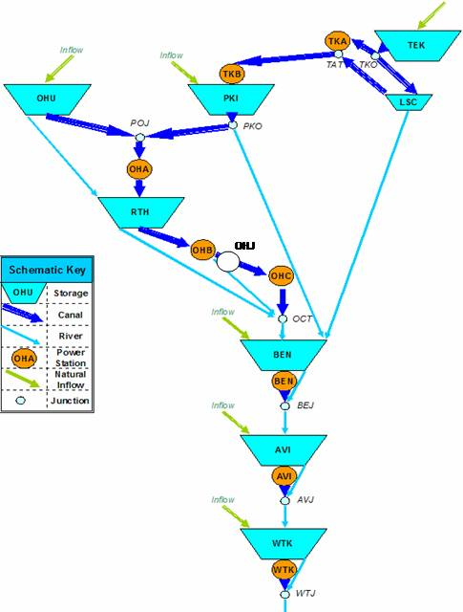
We simulate policy in this 18-node model
Electric Power Optimization Centre
WKO
MAN
HAW
The University of Auckland

Slide 9
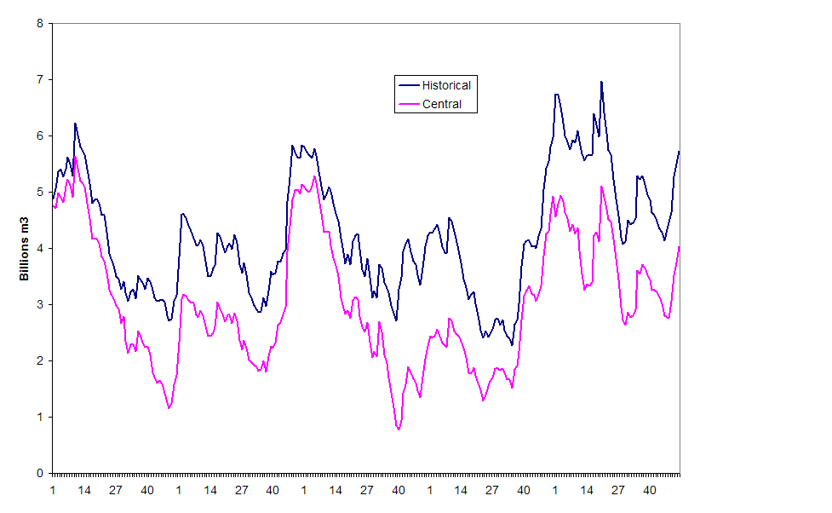
Historical vs centrally planned storage
Electric Power Optimization Centre
The University of Auckland
2005
2006
2007
2008
2009

Slide 10
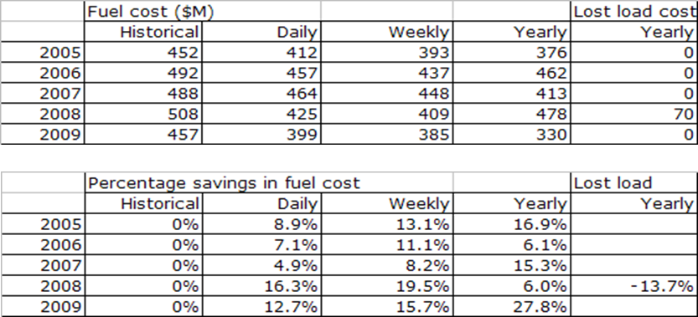
Additional annual fuel cost in market
Total fuel cost = (NZ)$400-$500 million per annum (est)
Total wholesale electricity sales = (NZ)$3 billion per annum (est)
Electric Power Optimization Centre
The University of Auckland

Slide 11
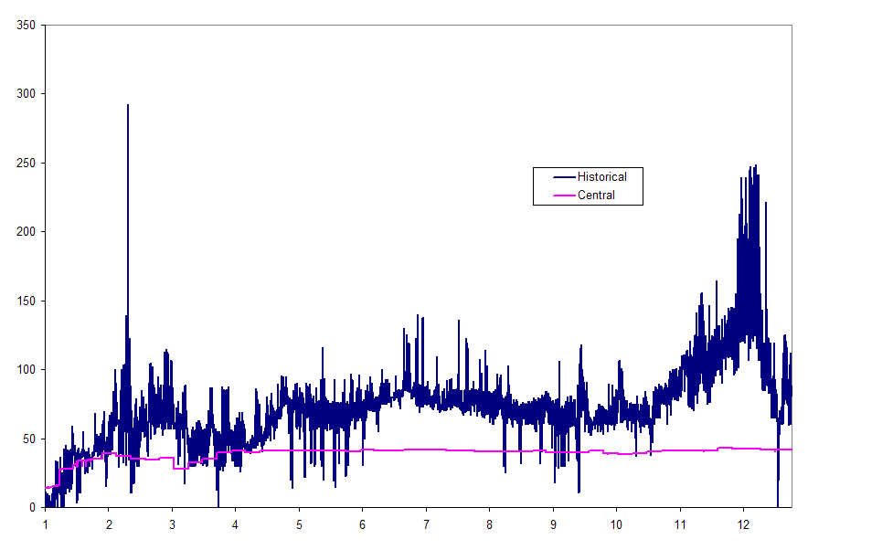
South Island prices over 2005
Electric Power Optimization Centre
The University of Auckland

Slide 12
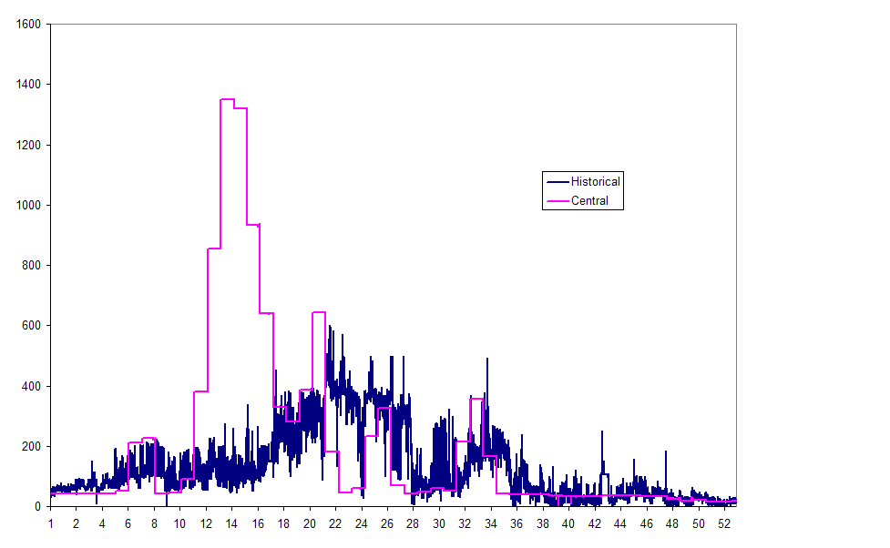
South Island prices over 2008
Electric Power Optimization Centre
The University of Auckland

Slide 13
Historical vs centrally planned storage
Electric Power Optimization Centre
The University of Auckland
2005
2006
2007
2008
2009

Slide 14
Measuring risk
The system in each stage minimizes its fuel cost in the current week plus a measure of the future risk.(Shapiro, 2011; Philpott & de Matos, 2011)
For two stages (next week’s cost is Z) this measure is:
ρ(Z) = (1-λ)E[Z] + λCVaR_{1−α}[Z]
for some λ between 0 and 1
Department of Engineering Science
Electric Power Optimization Centre
The University of Auckland
The University of Auckland

Slide 15
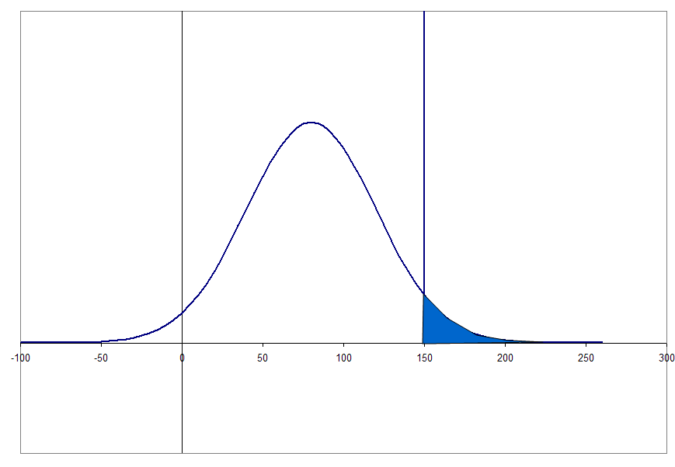
Value at risk VaR_{1−α}[Z]
frequency
α=5%
Electric Power Optimization Centre
The University of Auckland
cost
VaR_{0.95} = 150

Slide 16
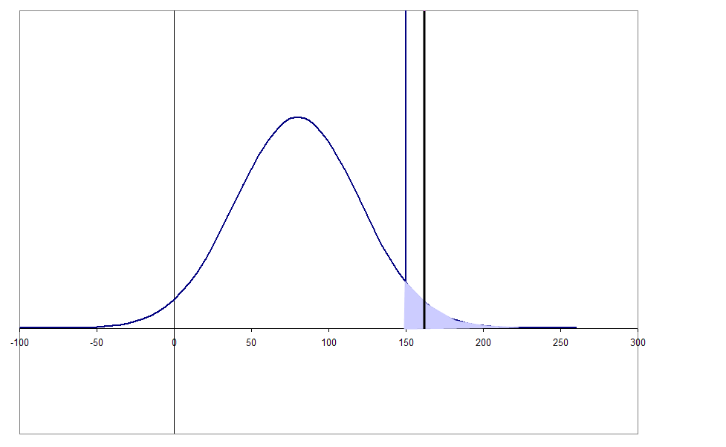
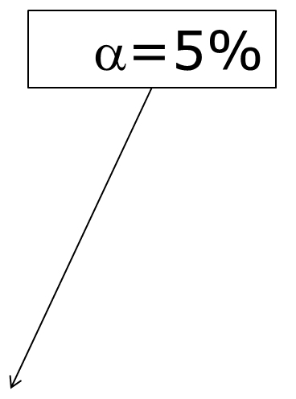
Conditional value at risk (CVaR_{1−α}[Z])
frequency
Electric Power Optimization Centre
The University of Auckland
cost
CVaR_{0.95} = 162

Slide 17
Recursive risk measure
For a model with many stages, next week’s objective is the risk ρ(Z) of the future cost Z, so we minimize fuel cost plus
(1-λ)E[ρ(Z)] + λCVaR_{1−α}[ρ(Z)]
for some λ between 0 and 1.
Here ρ(Z) is a certainty equivalent: the amount of money we would pay today to avoid the random costs Z of meeting demand in the future.(It is not an expected future cost)
Electric Power Optimization Centre
The University of Auckland

Slide 18
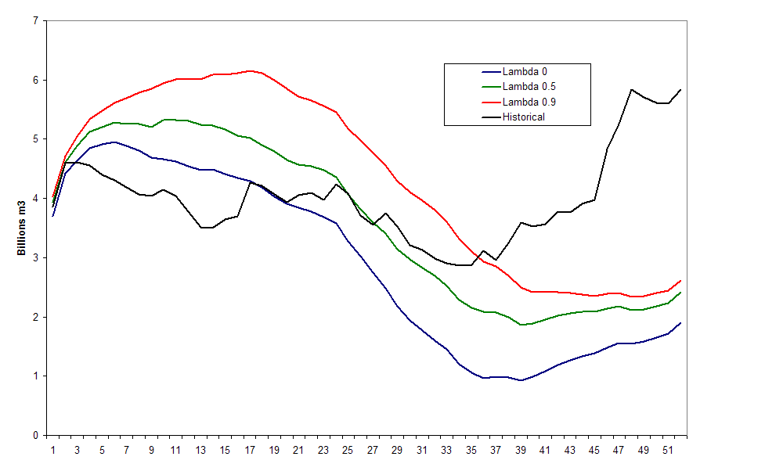
Simulated national storage 2006
Electric Power Optimization Centre
The University of Auckland

Slide 19
Historical vs centrally planned storage
Electric Power Optimization Centre
The University of Auckland
2005
2006
2007
2008
2009

Slide 20
Some observations
The historical market storage trajectory appears to be more risk averse than the risk-neutral central plan.
When agents are risk neutral, competitive markets correspond to a central plan.
so either…
agents are not being risk neutral, or the market is not competitive.
Question: Is the observed storage trajectory what we would expect from risk-averse agents acting in perfect competition?
Electric Power Optimization Centre
The University of Auckland

Slide 21
Ralph-Smeers Equilibrium Model
What is the competitive equilibrium under risk?
Assume we have N agents, each with a coherent risk measure ρ_{i} and random profit Z_{i}.
Electric Power Optimization Centre
If there is a complete market for risk then agents can sell and buy risky outcomes.
The equilibrium solves
V(Z₁,..) = min {Σ_{i} ρ_{i}(Z_{i}-W_{i}): Σ_{i} W_{i} =0}
Equivalent to using a system risk measure ρ_{s}(Σ_{i} Z_{i} )
The University of Auckland
Can compute equilibrium with risk-averse optimization.

Slide 22
Conclusion
When agents are risk neutral, competitive markets correspond to a central plan.
When agents are risk averse, competitive markets do not always correspond to a central plan. In general we need aligned risks, or completion of the risk market.
This is true even if there is only one risk-averse agent.
A new benchmark is needed for the multi-stage hydrothermal setting: risk-averse competitive equilibrium with incomplete markets for risk.
Electric Power Optimization Centre
The University of Auckland

