Slide 1
Implications of alternative metrics on mitigation costs and agricultural GHG emissions
Andy Reisinger¹ Petr Havlik^{2,3} Keywan Riahi² Oscar van Vliet² Michael Obersteiner² Mario Herrero³
¹ New Zealand Agricultural Greenhouse Gas Research Centre
² International Institute for Applied Systems Analysis (IIASA)
³ International Livestock Research Institute (ILRI)
Manuscript submitted to Climatic Change
Work funded by NZ Ministry of Agriculture and various EU-FP7 programs

Slide 2
In a nutshell
100-year GWPs are not a cost-effective way of comparing GHGs
Alternative bio-physical metrics address some problems of GWPs – but few studies have explored the cost and climate policy implications if such metrics were to replace GWPs.
Determine the global cost-effectiveness of different metrics under a variety of other assumptions
100-year GTPs
Time-dependent GTPs (focused on 2100)
Exclusion of agricultural non-CO₂ emissions
Evaluate regional implications of alternative metrics for agricultural production and non-CO₂ emissions

Slide 3
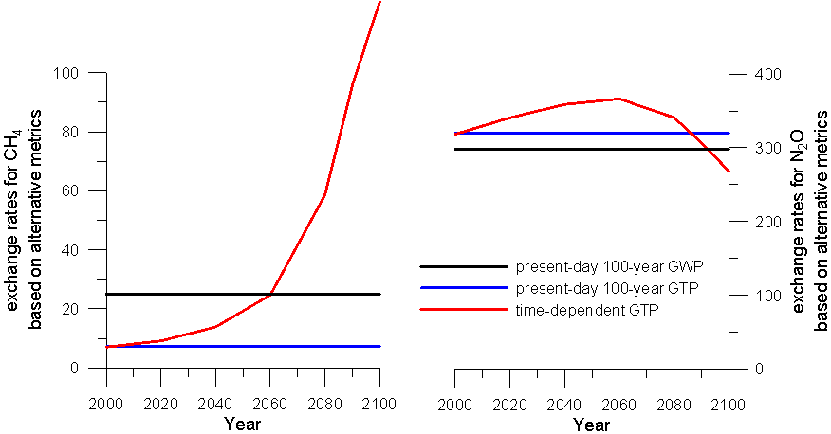
Alternative metrics: GWPs, fixed and time-dependent GTPs
CH₄ N₂O

Slide 4
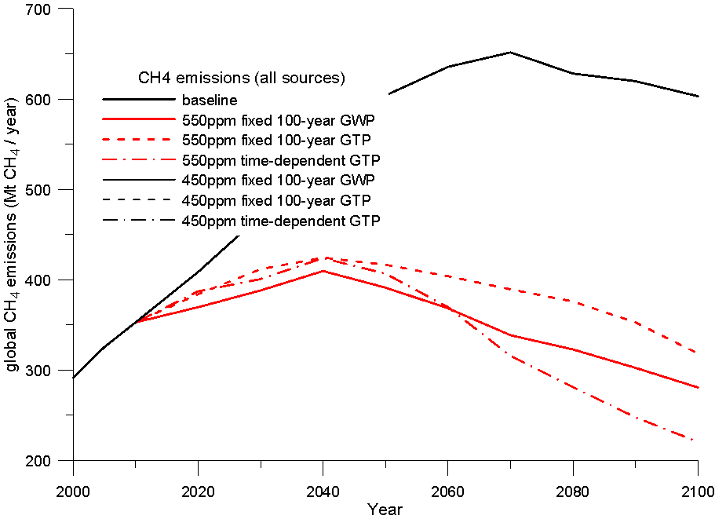
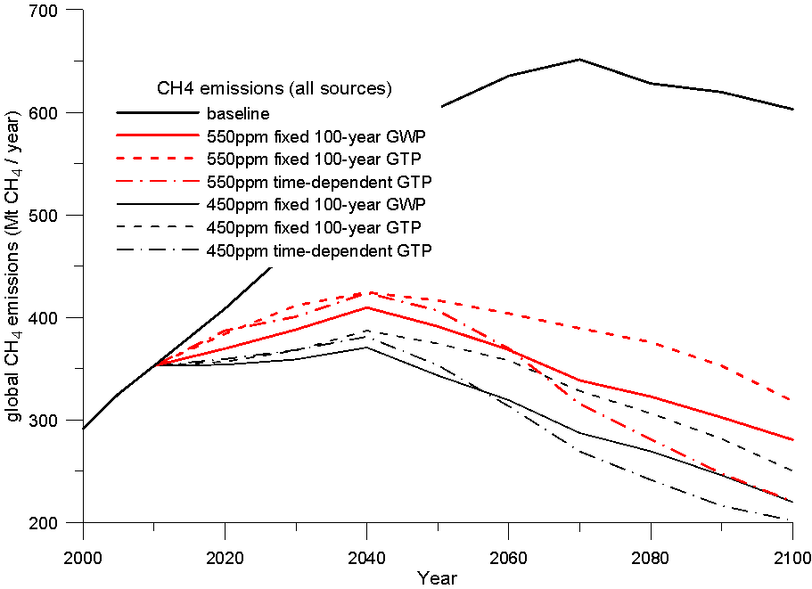
Emissions paths under alternative metrics using MESSAGE
fixed 100-year GTPs: less CH₄ mitigation
time-dependent GTPs: more CH₄ mitigation
by 2100
Global agricultural marginal abatement costs from Beach et al. (2008)

Slide 5
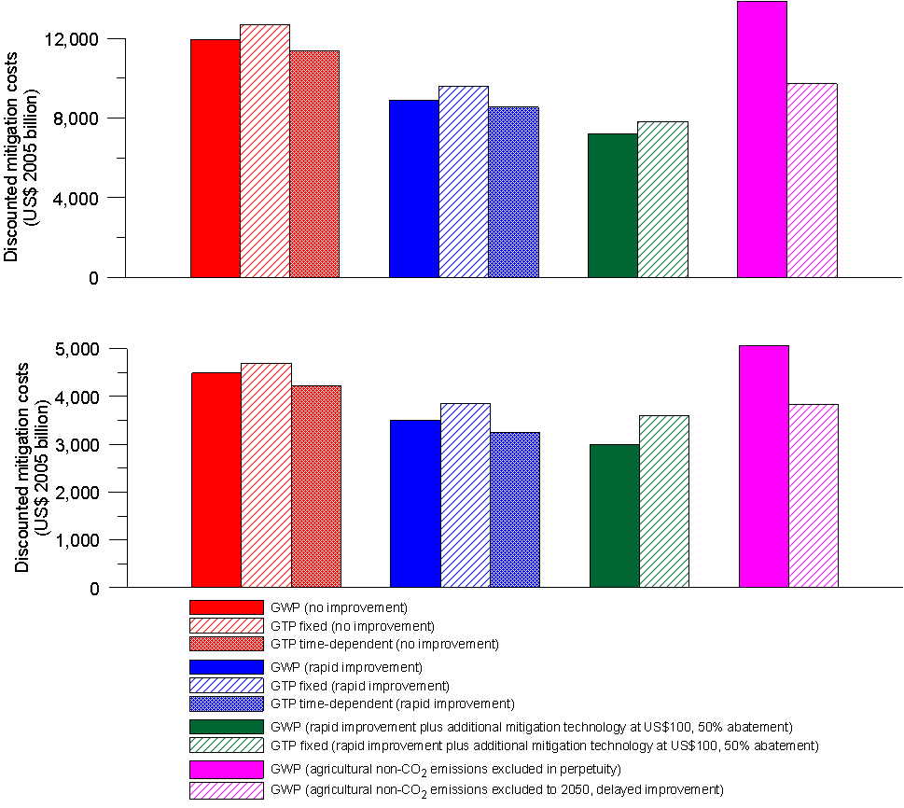
Global agricultural CH₄ emission pathways
Global net costs
MESSAGE results
450ppm
CH₄ mitigation determines ‘atmospheric space’ for CO₂ emissions
and hence total mitigation costs
550ppm

Slide 6
Global agricultural CH₄ emission pathways
Global discounted net present value mitigation costs (2010-2100)
Example for 550ppm CO₂-eq stabilisation

Slide 7
Global cost-effectiveness of metrics
Fixed GTPs result in higher CO₂ prices and higher total mitigation costs than GWPs
Time-dependent GTPs (focusing on year 2100) result in lower CO₂ prices and lower total mitigation costs than GWPs, but escalating CH₄ prices raise question about practical feasibility
Assumptions about agriculture mitigation potential have a larger effect on global costs than alternative metrics
Different long-term stabilisation targets have a much larger effect on global costs than alternative metrics
Excluding agriculture globally is by far the most costly ‘metric’

Slide 8
Regional implications
Use GLOBIOM to model agricultural production to 2050
Spatially explicit partial equilibrium model for agriculture and forestry (Havlik et al. 2010)
Impose shadow prices for CO₂, CH₄ and N₂O and biofuel demands from global MESSAGE stabilisation runs under alternative metrics:
100-year GWPs (default)
Fixed 100-year GTPs
agricultural non-CO₂ emissions excluded
Explore regional agricultural production and GHG emissions under additional GHG costs in all regions, and effects on supply prices of livestock products

Slide 9
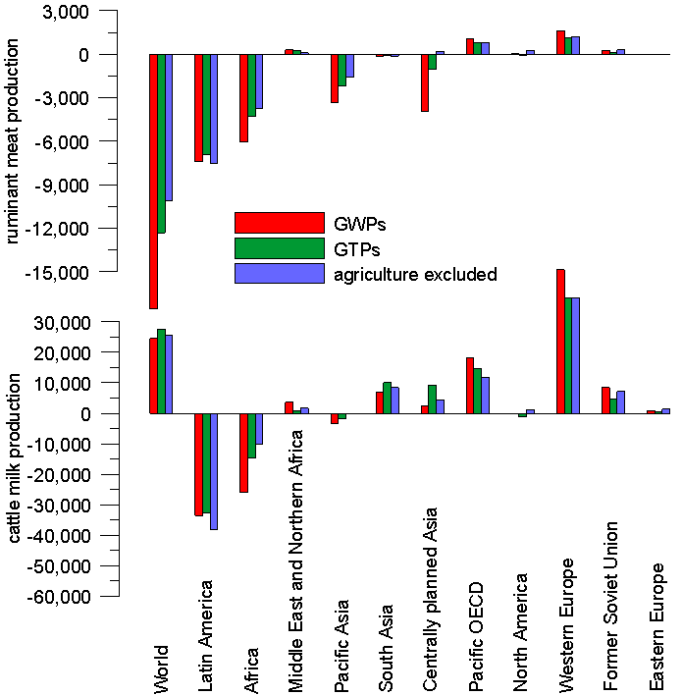
Global agricultural CH₄ emission pathways
Regional changes in livestock production
2030
Ruminant meat
Cattle milk
Metrics have different effects regionally.
But the decision to impose a cost has a bigger effect in most regions than the metric by which the cost is imposed.
Some regions benefit from a global mitigation response because it increases their competitive advantage.

Slide 10
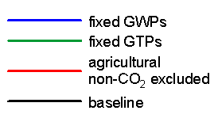
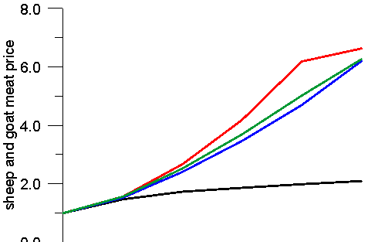
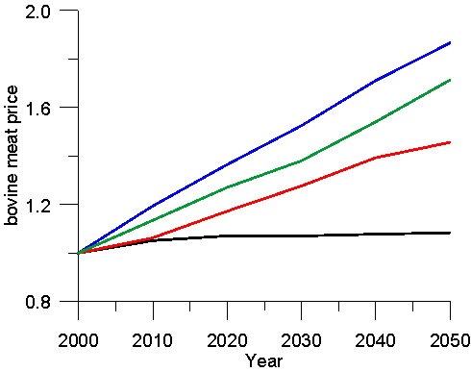
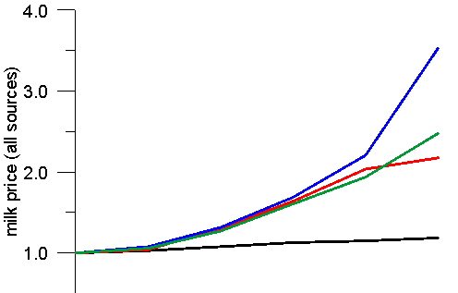
Regional changes in supply prices
Where future production increases require land-use change, CO₂ prices dominate the response.
Otherwise, non-CO₂ prices are more important.
0.0

Slide 11
Conclusions
GWPs are not the most cost-effective metric to compare GHGs
Fixed 100-year GTPs are even less cost-effective (+ 5 to 10%) time-dependent GTPs would be more cost-effective (- 4 to 5%)
Cost implications of alternative metrics: smaller than alternative assumptions about future agricultural mitigation potential, and much smaller than choices of long-term target
Regional implications: depending on production systems and land-use change, non-CO₂ or CO₂ prices have the dominant effect on future production and supply prices
Further work: explore the implications for the political economy of climate agreements, especially given their interaction with supply prices and land-use change

Slide 12
Global GDP losses
Impacts on global GDP
Time-dependent GTPs defer
some mitigation costs
to future generations

Slide 13
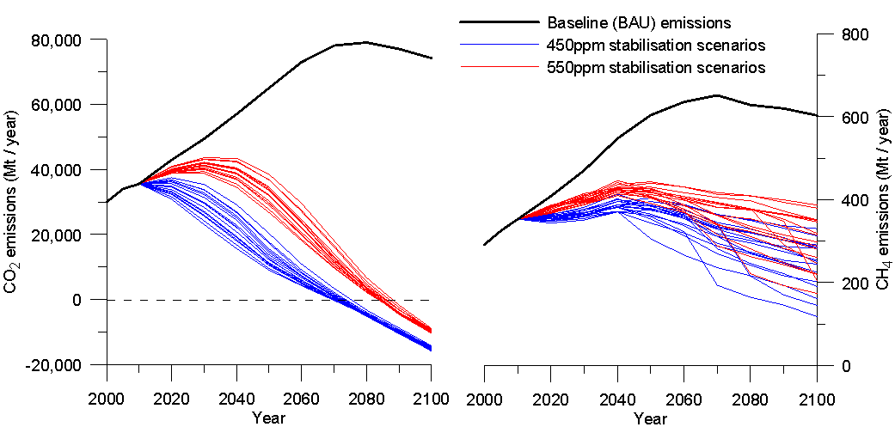
Emissions paths under alternative metrics using MESSAGE
Emissions paths for full set of metrics and assumptions for agricultural abatement potential

