Slide 1
The impact of the NZETS on local communities: spatially modelling the distribution of GHG liabilities
Motu Climate Research Workshop
20 March, 2012
Levi Timar (GNS and Motu)

Slide 2
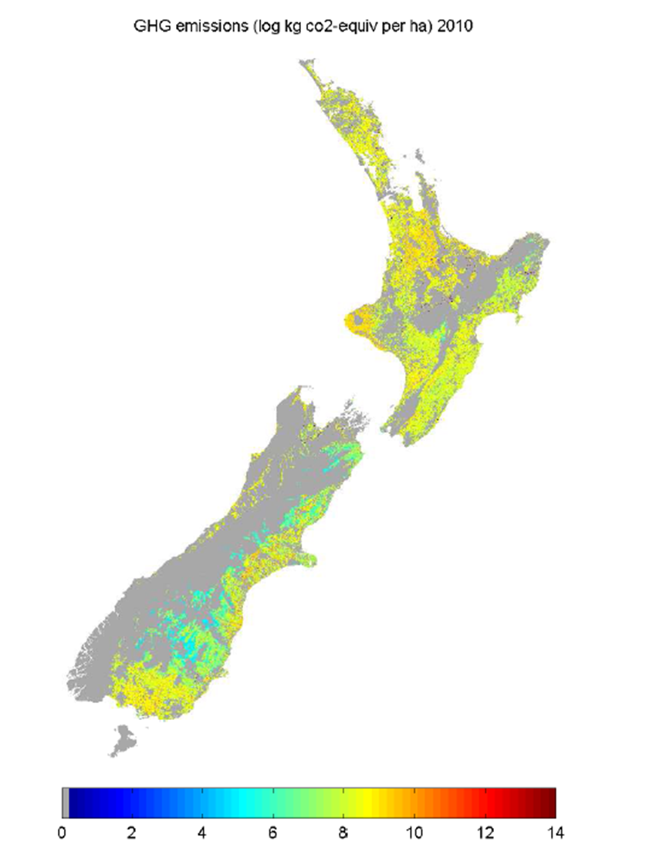

Slide 3
Motivation
How are the costs of agricultural emissions policy distributed? What types of farms are most affected? What regions can benefit most from forestry sequestration?
What effect does the allocation of emission permits have on the distribution of costs? Can we alter the distribution of costs to achieve social objectives?
Robustness check for LURNZ

Slide 4
Net Emission Liabilities
Full emissions charge in agriculture (no free allocation of emissions permits)
All post-89 forest owners receive credits equivalent to the annualized discounted present value of carbon sequestered during the first 10 years of a plantation (5-11 tonnes per hectare)
Pre-90 forest and scrub currently not in policy

Slide 5
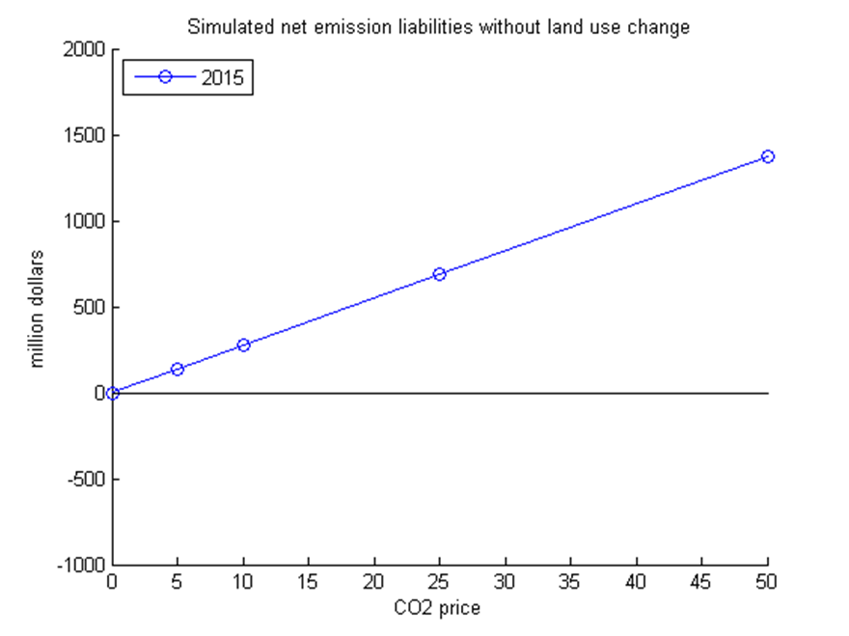

Slide 6
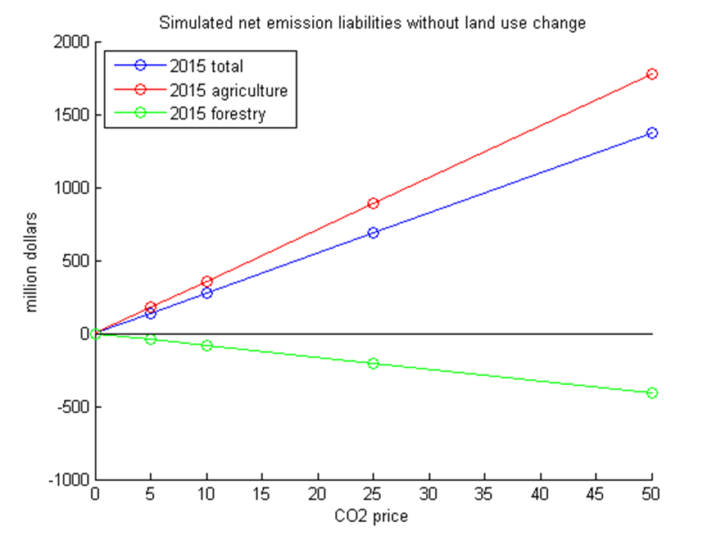

Slide 7
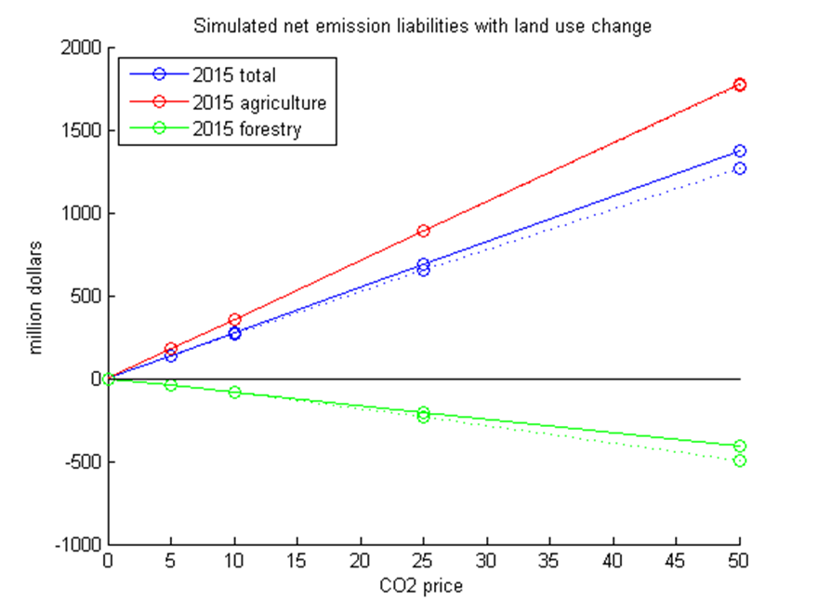

Slide 8
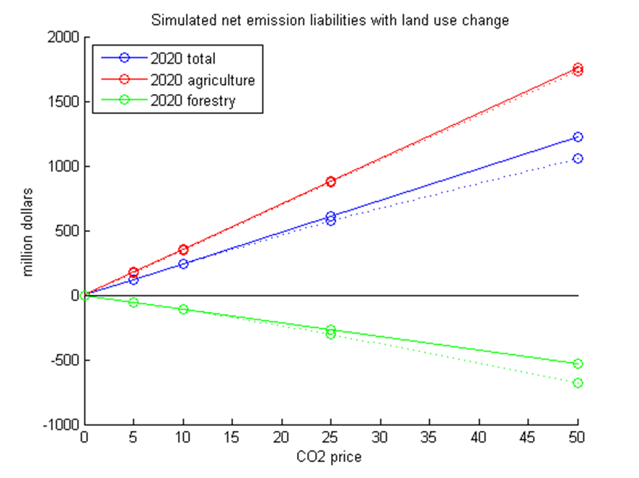

Slide 9
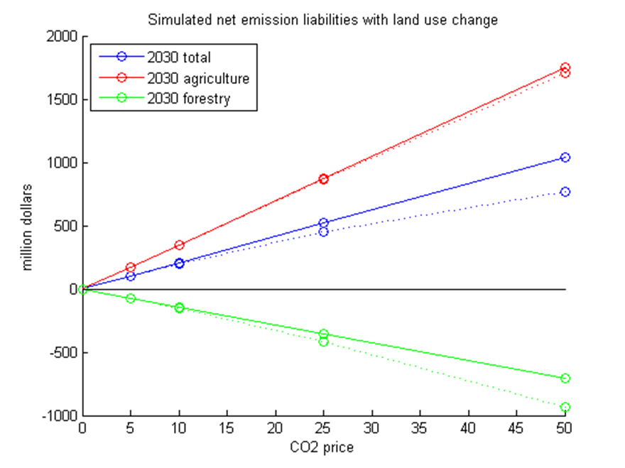

Slide 10
Land Use Change Costs
Land use change can reduce emissions, but it is not costless to change land use
By incrementally changing the CO2 price in simulations and subtracting total emissions from those under the baseline, we can trace out the MC of abatement curve
Area under the curve is total abatement cost (i.e. the cost associated with land use change)

Slide 11
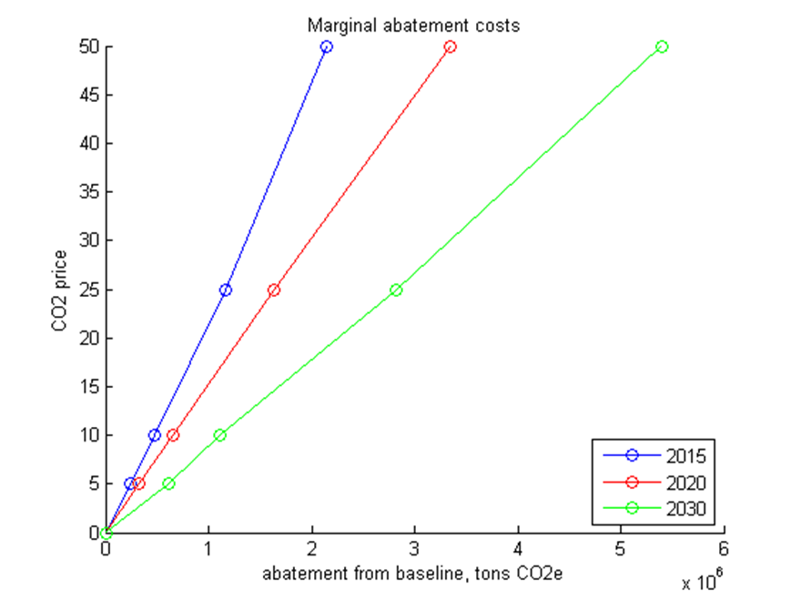

Slide 12
Impact of ETS Policy
Total cost of policy =
net liabilities + total abatement costs
Consider impacts by geographic region or impacts by land tenure type
Net liabilities spatially heterogeneous
Assume total abatement costs are proportional to share of land use change in region or tenure class

Slide 13
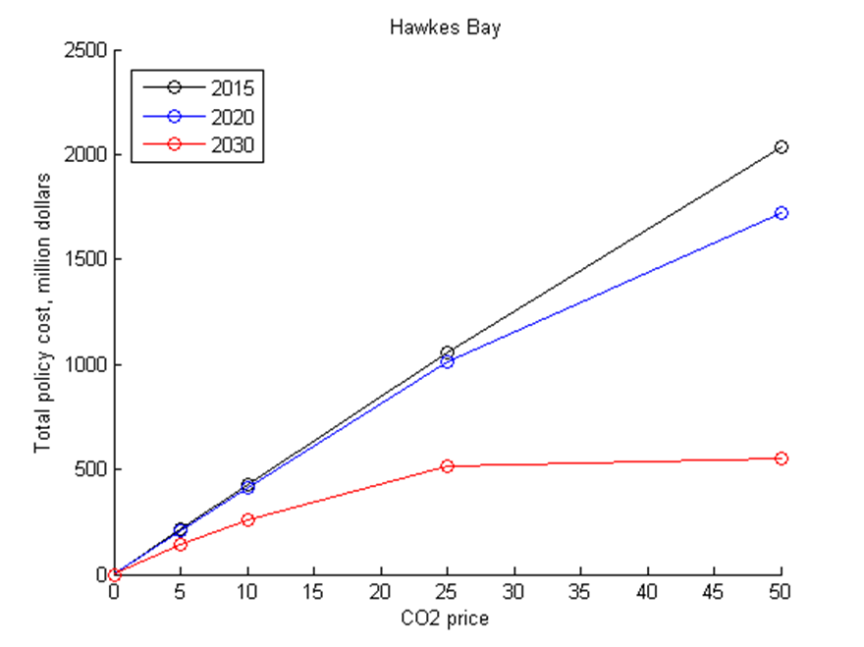

Slide 14
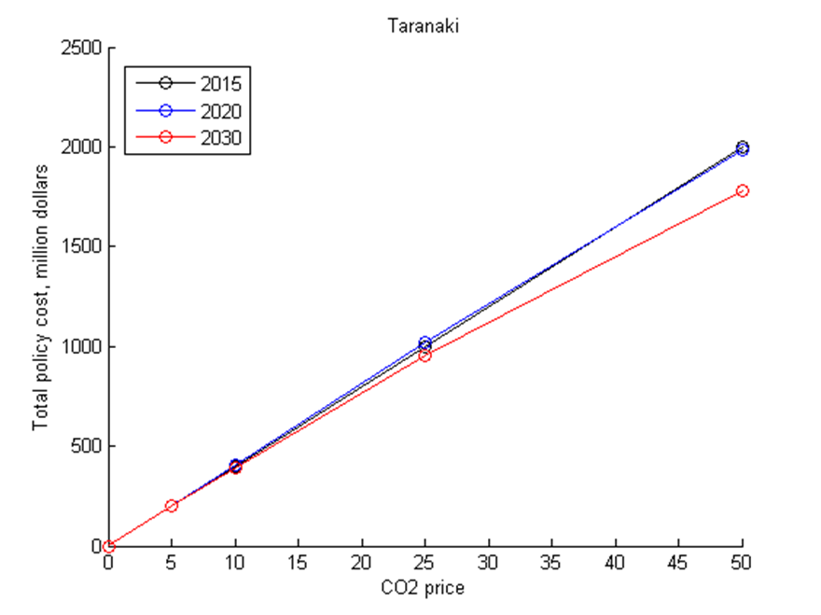

Slide 15
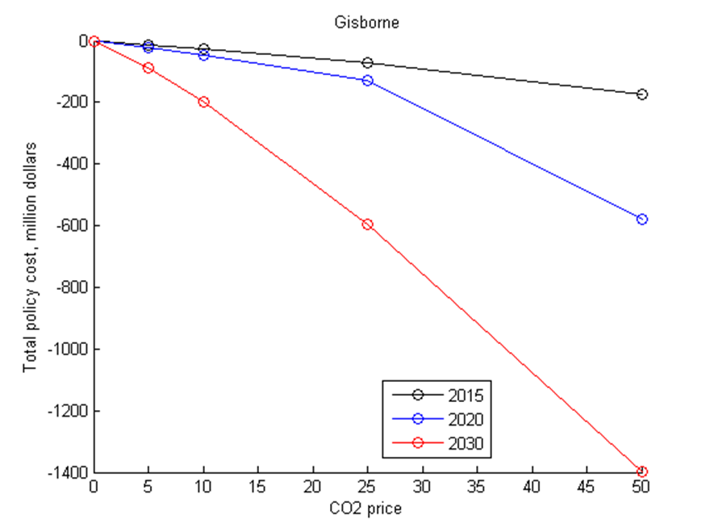

Slide 16
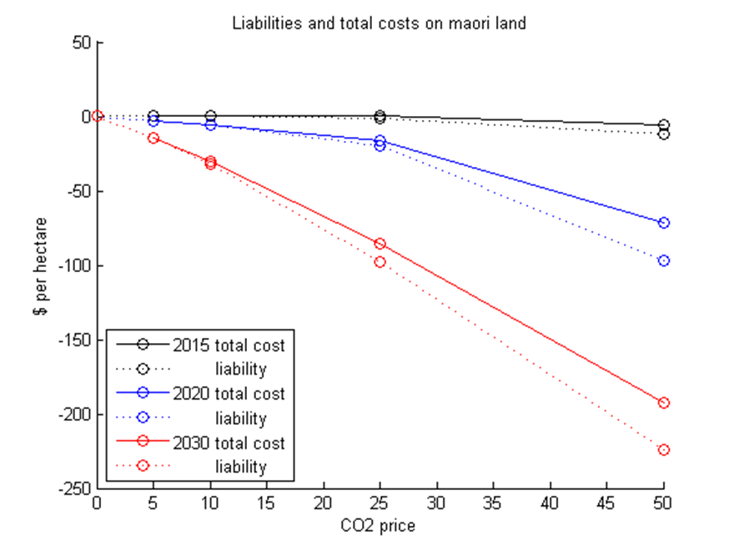

Slide 17
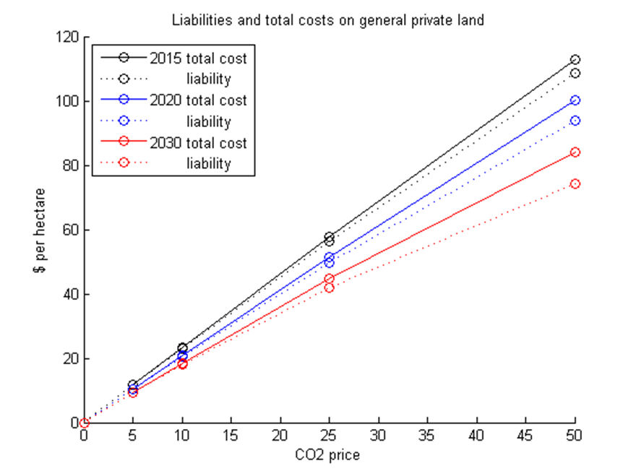

Slide 18
Motivation
How are the costs of agricultural emissions policy distributed? What types of farms are most affected? What regions can benefit most from forestry sequestration?
What effect does the allocation of emission permits have on the distribution of costs? Can we alter the distribution of costs to achieve social objectives?
Robustness check for LURNZ

Slide 19
Caveats
Agricultural subsidies and taxes are to a large extent capitalised into land values
Current results have too much land use change (based on nominal price projections)
Deforestation not linked to harvest
All post-89 forest assumed to join ETS

